Slide 1


EDPA International/IFES
Country Report
A Local Knowledge Report
From Exhibit/Event Service Providers
India

Slide 2
Presentation Prepared By
Kingsmen Fairtech Interiors Pvt Ltd
B1 Extension/ F1, Mohan Co-operative, Mathura Road,
New Delhi – 110044.
Tel: (011) 46606100

Slide 3
India: Facts and Figures

Slide 4
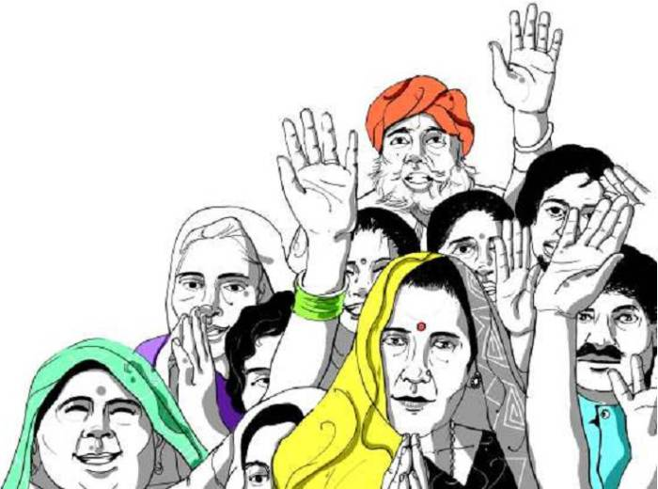
Facts & Figures
Population approx: 1.37 Billion
Country Size: 3,287,590 km²
Main language(s): English and Hindi
Capital City: New Delhi
Population: 11 Million (approx.)
Largest City: Mumbai
Population: 12.5 Million (approx.)

Slide 5
Money Issues
Currency: Indian Rupee (INR)
Standard conversion rate 1 USD = 71 INR (approx.) in October, 2019.
Visa, MasterCard & American Express widely accepted, especially in metropolitan areas like Mumbai, Delhi, Chennai, Bangalore and Hyderabad. India is slowly moving towards being a cashless economy. The digital wallet or e-wallet is making the life easier.
Unlike US, credit cards are not compulsory at shows for services in India. They are merely used as a mode of payment. Other alternatives to credit cards are cheque, cash, NEFT, RTGS and demand draft.
Commerce in India often includes negotiation.
GST is applicable on all the services that an individual avails. Also, the percentage of GST charged varies from industry to industry. You cannot claim a refund.

Slide 6
Size and Distance Information

Slide 7
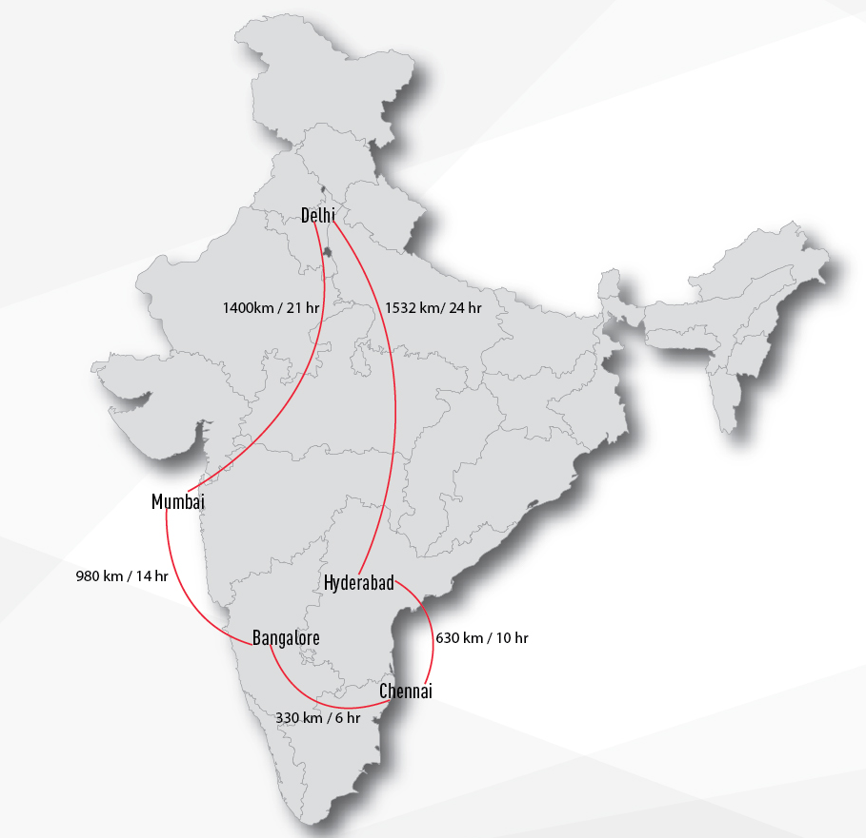


Slide 8
Location of Major Venues

Slide 9
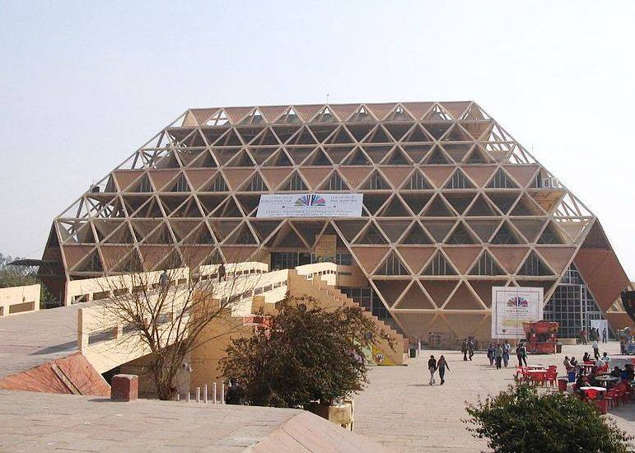
Pragati Maidan
New Delhi
(www.pragatimaidan.info)
Largest purpose built exhibition space in India’s capital region.
Owned and managed by Indian Trade Promotion Organisation (ITPO) - Ministry of Commerce and Industry, Govt. of India.
17 halls and over 70,000 sq.m of exhibition space.
Some Major Exhibitions:
Auto Expo
India International Trade Fair
Nehru Pavilion
Atomic Energy and Defense Pavilion
World Book Fair
PlastIndia

Slide 10
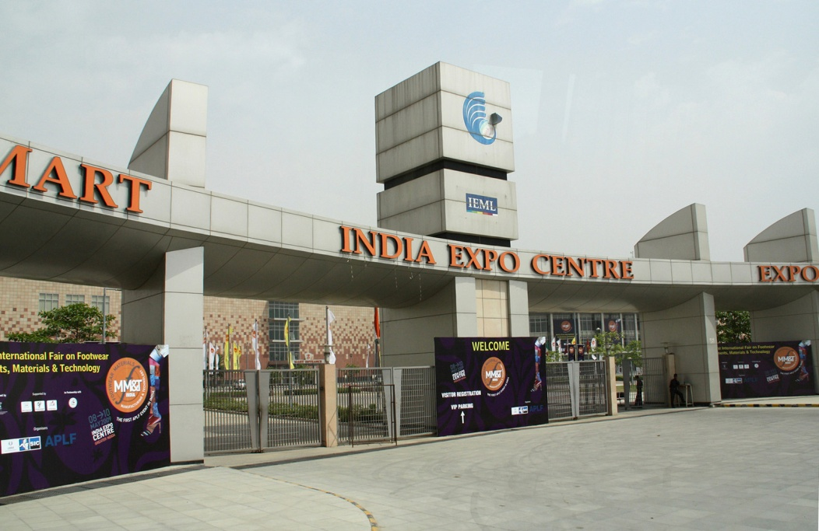
India Trade Expo Centre
Delhi NCR
(www.expocentreindia.com)
10000sq.m of indoor space and 10000sq.m of open area.
5 exhibition halls with additional conference room, 5 meeting rooms, Warehousing and an underground and over-ground parking space.
Some Major exhibitions:
PET+DrinkTech Asia
World Dental congress
Renewable Energy India
Aquatech
Petrotech
Auto Expo

Slide 11
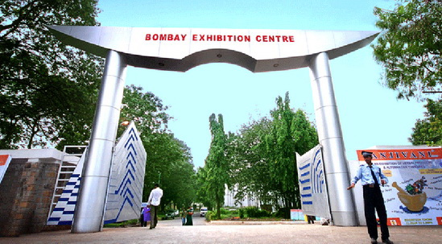
Bombay Convention and Exhibition Centre
Mumbai
(www.nesco.in)
Among the largest permanent private exhibition centers in India.
4 exhibition halls with over 45000sq.m area.
Some Major exhibitions:
ACETECH India
Chemtech
CPHI
India International Jewellery Show (IIJS)
InfoComm

Slide 12
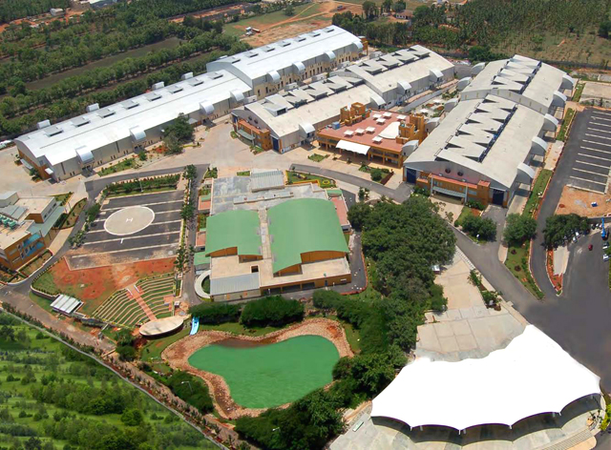
Bangalore International Exhibition Center Bangalore
(www.biec.in)
Premier international exhibition-cum-conference facility.
3 exhibition halls with 40000sq.m area.
5000sq.m open display area.
VIP lounge, business centre, conference center, food court and other support services.
Some Major exhibitions:
Imtex
Agritech
CeBIT India
Bangalore Space Expo
Alucast
Acrex India

Slide 13
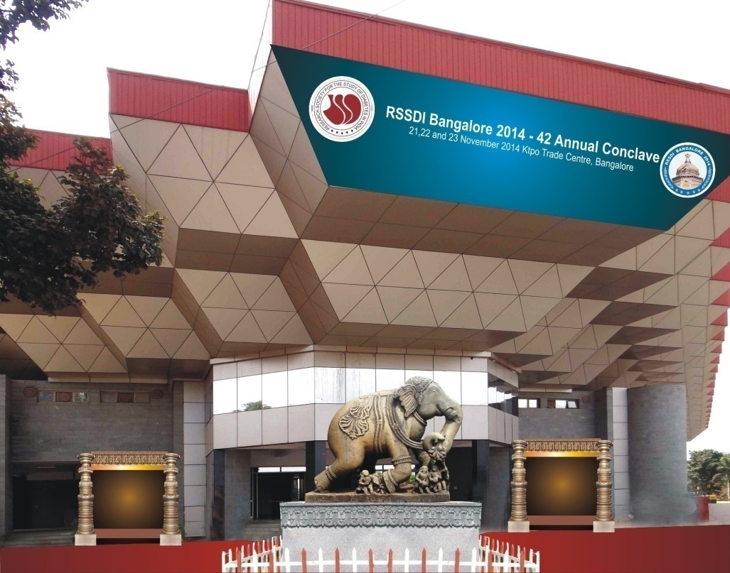
KTPO Trade Centre
Bangalore
(www.ktpo.org)
4 exhibition halls with over 20000sq.m of area.
Conference room for 200 delegates, 2 halls for press conference, a lobby and a VIP lounge
Some Major exhibitions:
India International Travel Mart
Food Hospitality World
Natural Living Expo
Aahar International food fair
Solarcon India
International Natural Products Expo

Slide 14
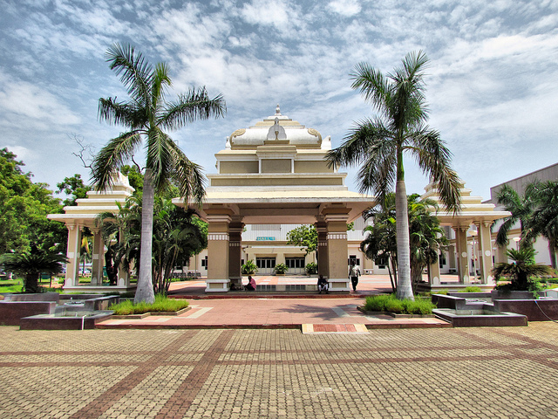
Chennai Trade Centre
Chennai
(www.chennaitradecentre.org)
3 exhibition halls and 1 convention center - Over 17000sq.m area.
Open-Air theatre, VIP rooms, Green rooms, Service room, Media Room, Meeting room, Storage room, Reception and organizers room.
Some Major exhibitions:
Wood Tech India
Baicon
Tyre Expo
India International Leather Fair
Hitex International Machine Tool Expo

Slide 15
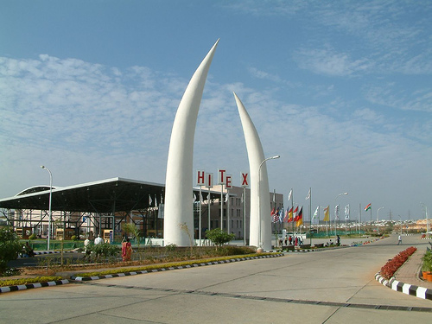
Hitex Exhibition Center
Hyderabad
(www.hitex.co.in)
3 exhibition halls with 10500sq.m area.
5 outdoor exhibition spaces and 2 open grounds for events and fairs.
1 large conference hall and 5 meeting rooms.
Some Major exhibitions:
Furniture Fair
Food Service Expo
India Lab Expo
PackPlus
ProcessExpo

Slide 16
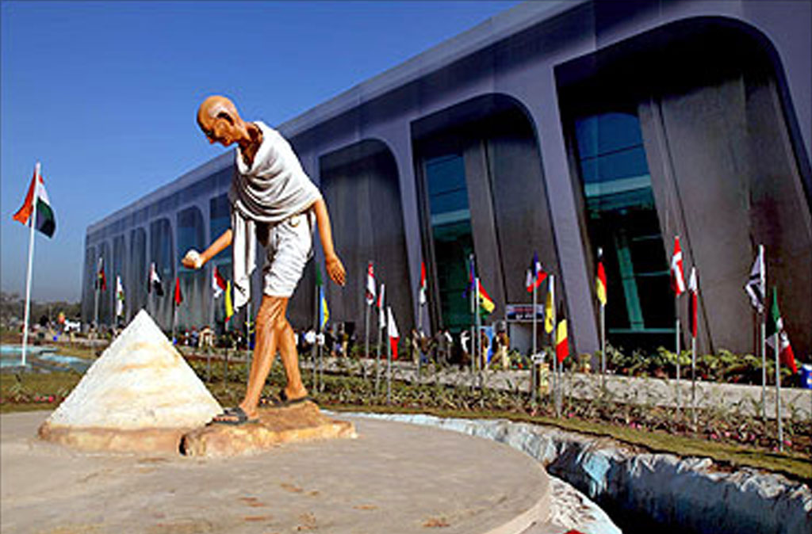
Mahatma Mandir
Gujarat
(https://www.theleela.com/en_us/gujarat/mahatma-mandir-convention-and-exhibition-centre/)
The Complex:
The complex site is spacious enough to handle swift movement of up to 15,000 people.
The Convention hall has seating capacity of 5000 seats undivided with VIP viewing gallerias.
The Convention Centre:
Capacity- 5000 seats (undivided) plus VIP viewing galleries.
Seminar Halls, Meeting Rooms & Conference Rooms:
4 Seminar Rooms each having a capacity of 500 and 1000 seats
The Exhibition Centre:
For exhibitions and various other programmes.

Slide 17
Exhibition Facts and Figures

Slide 18
General Information
Good mix of local and international organizers. Prominent among locals are UBM and ABEC. International organizers include Messe Frankfurt, Messe Dusseldorf, Reed and Colonge Messe.
Organizers are into space selling and provision for Shell scheme system booths. They also provide utilities like electricity, water, Wi-Fi, etc.
All other services like booth solutions, fabrication, designing, printing and catering can be sub-contracted to exhibition service providers.
There are no trade unions in terms of exhibiting in India. You are allowed to staff your own workforce or service contractor.
Rigging is non-existent and there are no facilities to execute the same.
Move in / move outs can be sluggish in the absence of appropriate facilities. Give yourself ample time to execute this.
Health and safety standards are followed sporadically to its western counterparts. Although, newly built exhibition spaces like Hitex and BIEC are state-of-the-art and adhere to these standards.
Permissions for building need to be taken from organizers. Solution providers or agencies can these permissions on behalf of the exhibitor. Mezzanine structures need an additional architectural certificate.
Exhibition grounds are not dust protected.

Slide 19
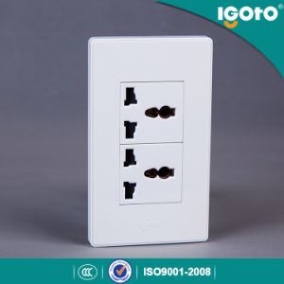
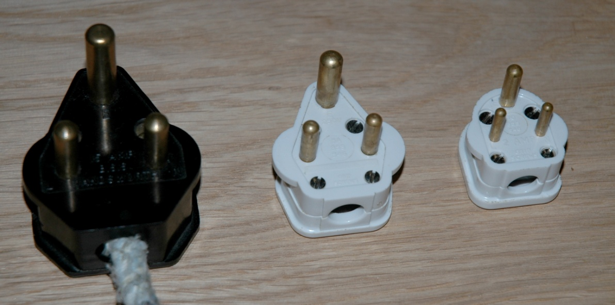
Electrics and Electricity
Although, Many power outlets are universal and accept many plugs without adapter. A combination receptacle for types C, D and M is usually present.
Plug Standard: IS 1293
Typical Voltage: 230V 50Hz
Electricians must be certified and/or licensed.

Slide 20
Labour Cost Estimates
Labour is considerably cheaper in India in comparison to US and even EU continent
General Labourer: 11$ – 14$ / 8 hrs - Per day*
Experienced Labourer: 15$ – 18$ / 8 hrs - Per day*
Site Supervisors: 32$ – 82$ / 8 hrs - Per day*
Custom Stand Builders: 29$ – 55$ / 8 hrs - Per day*
(approximate figures)*

Slide 21
Materials Usage
Indian exhibitions prefer raised platform since flooring may be uneven.
Carpets commonly of 4 types: Plain, Rib, Loop and Cut Pile.
Plain – 0.5$ sq/ft
Rib – 0.5$ sq/ft
Loop – 1.5$ sq/ft
Cut pile – 2.0$ sq/ft
Platforms are 35MM or 100MM. Laminated flooring can be standard or 8MM thickness. Laminates typically carry an additional charge.
Traditional material such as wood, metal, mdf and plywood preferred over more contemporary materials.
Sun board is a similar product variant for Forex in India.
Cost of material hugely dependent on quality. But overall considered cheap due to differences in currency value and cheap supporting ancillaries such as labor, transportation and resources.

Slide 22
Shopping Tips
Dedicated stores such as IKEA are not common in India. However, many retail stores and unorganized shopping markets have almost all material you would be sourcing.
These retail stores are similar to large scale general stores. They are mostly chain outlets available at most metropolitans. Examples: Big Bazaar.
Other shopping examples:
Home improvement stores:
Homestop (for home décor and furniture) http://corporate.shoppersstop.com/Brand/Homestop.aspx
Unorganized market for home improvements and fabrication material
Crawford Market in Mumbai
Retail Electronic stores:
Croma (www.cromaretail.com)
Vijay sales (www.vijaysales.com)
Ezone (www.ezoneonline.in)
Unorganized market for cables and hardware:
Lamington Road in South Mumbai
22

Slide 23

EDPA International Members
Active in this country
Kingsmen Fairtech Interiors Pvt Ltd
www.kingsmenindia.com
23

Slide 24

Thank You

