Slide 1
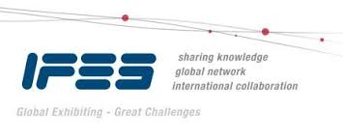

EDPA International/IFES
Country Report Template
A Local Knowledge Report
From Exhibit/Event Service Providers
Taiwan

Slide 2

Presentation Prepared By
Kingsmen Taiwan (International) Co., Ltd
8F,.No 1,Sec.4, Nanjing E Rd., Taipei city 105, Taiwan R.O.C

Slide 3
Taiwan Facts and Figures

Slide 4
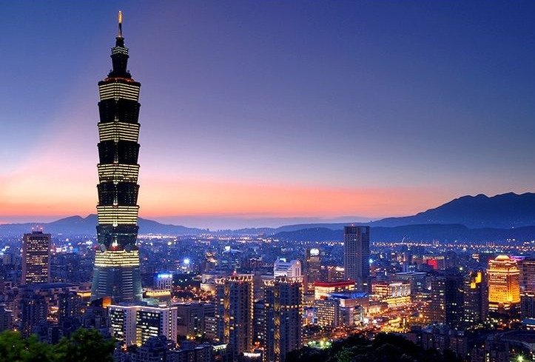
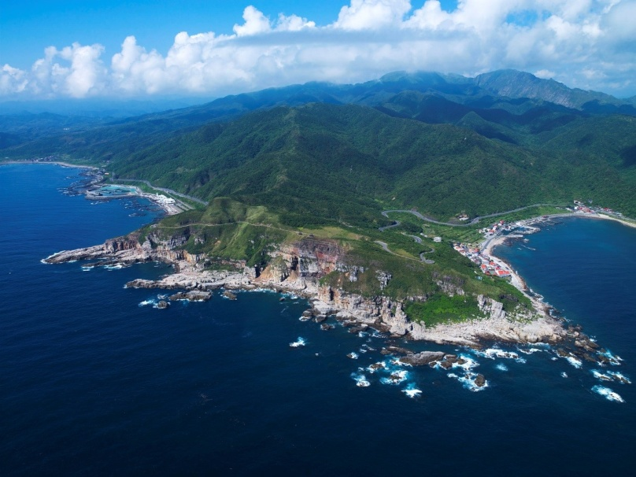
Facts & Figures
Population approx:
23,392,036
Main language(s):
Mandarin & Taiwanese Chinese
Country Size: 36,193 SQM
Capital City, population:
Taipei city, 2,693,672
Largest City, population
New Taipei city, 3,956,728

Slide 5
Money Issues
What is the standard currency? What is a standard conversion rate?
NTD is the standard currency. 1 USD = 30 NTD
Are credit cards widely accepted? Should the traveller plan on dealing with lots of cash? Yes, both cash and credit cards are accepted in most places.
Are credit cards required (like in the US at shows for services)? Cash is usually accepted for on-site services.
Hints regarding tipping (taxis, restaurants, bars, baggage handlers, etc.) and/or haggling? There is a 10% service charge in restaurants and bars, tipping or haggling is uncommon.
Is there a VAT? How high is it? Who needs to pay it? Is there a way for Americans to get it refunded? Is there a useful website (in English)?
Yes, there is a 5% VAT. Clients need to pay for it. Not all items are eligible for VAT refunds. Useful website: http://www.dot.gov.tw/en/index.jsp

Slide 6
Size and Distance Information

Slide 7
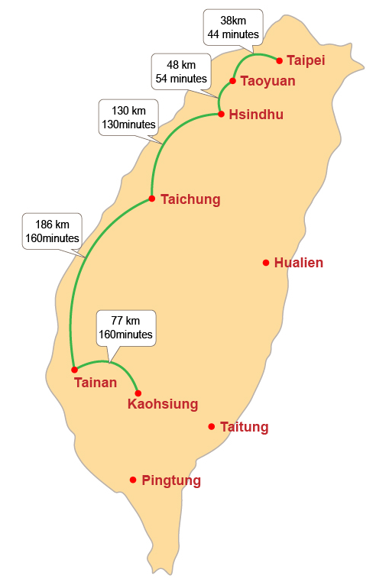
Semi trailer rates / return trip
from Taipei – Taichung
are approx. 216KM, 4HR
are approx. NTD 30,000 + VAT
Semi trailer rates / return trip
from Taipei – Taichung
are approx. 479KM, 9HR
are approx. NTD 50,000 + VAT

Slide 8
Location of Major Venues – North Taiwan

Slide 9
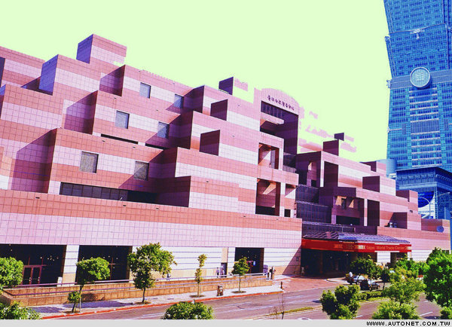
Taipei World Trade Center Hall 1
http://www.twtc.org.tw/en/e-index.aspx
The TWTC was started in January, 1986 by Taiwan's foremost trade promotion organization, the Taiwan External Trade Development Council (TAITRA), to provide a single, modern venue that would combine exhibition space, conference facilities, offices, and hotel accommodation for international business. TWTC combines every possible service that brings together a vast consulting service on trade-related issues, trading partners, suppliers, and markets.
The Exhibition Hall 1 , has 7 floors (office from 2~7 floors), with a total of 2,345,000 sqm of floor space and can house 1,304 standard booths

Slide 10
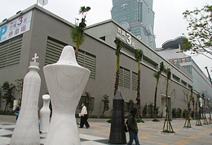
Taipei World Trade Center Hall 3
http://www.twtc.org.tw/en/e-index.aspx
The TWTC was started in January, 1986 by Taiwan's foremost trade promotion organization, the Taiwan External Trade Development Council (TAITRA), to provide a single, modern venue that would combine exhibition space, conference facilities, offices, and hotel accommodation for international business. TWTC combines every possible service that brings together a vast consulting service on trade-related issues, trading partners, suppliers, and markets.
The Exhibition Hall 3 , has 2 floors (1st floors for Exhibition, 2nd for Parking area), with a total of 7,481 sqm of floor space and can house 365 standard booths.

Slide 11
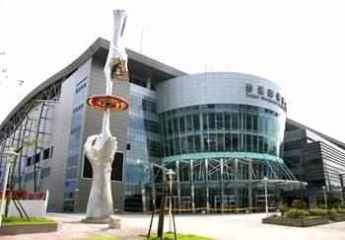
Taipei Nangang Exhibition Center，Hall 1 https://www.tainex1.com.tw/en/
Taipei World Trade Center Nangang Exhibition Hall (TWTC Nangang) is a superimposed purpose-built exhibition complex in Nangang, Taipei. It is located to the east of Taipei World Trade Center (TWTC).
This complex is Taiwan's largest trade-show venue
Capacity: Able to house 2,467 standard-size (3x3 meters) booths and occupies an exhibition space of 45,360 sqm.
Construction began in March 2005, costing US$ 110 million, and was completed in March 2008.

Slide 12
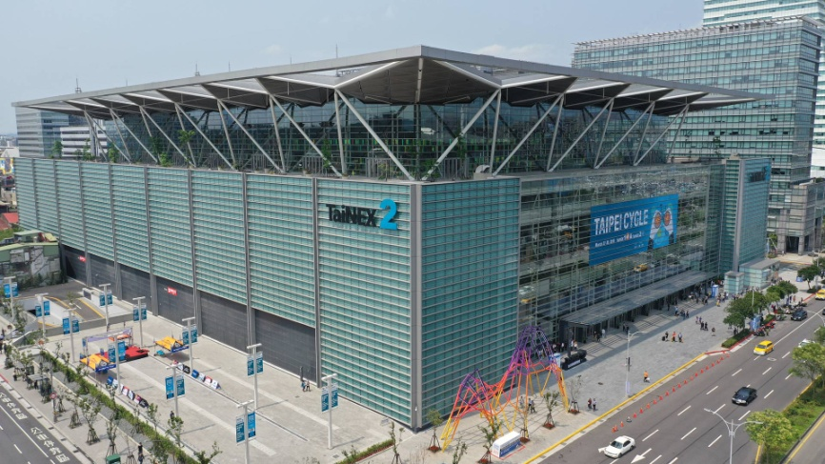
Taipei Nangang Exhibition Center，Hall 2
https://www.tainex2.com.tw/en/
Taipei Nangang Exhibition Center, Hall 2 (TaiNEX 2), a new venue funded by the Ministry of Economic Affairs (MOEA) and operated by Taiwan External Trade Development Council (TAITRA). It offers 156,700 sqm floor space to accommodate 32,000 visitors for exhibitions, conferences, business meetings and events. Combined with the spaces already available in Taipei Nangang Exhibition Center, Hall 1, the total capacity holds more than 5,000 booths and 38 meeting rooms. These two exhibition centers are expected to become the core venues of Taiwan's MICE industry, as well as one of the major convention and exhibition centers in Asia.

Slide 13
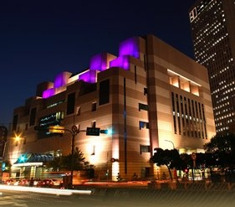
Taipei International Convention Center
https://www.ticc.com.tw/main_en/index.aspx
The Taipei International Convention Center (TICC) is a spectacular tribute to the emergence of Taipei as a world-class business destination. Purpose-built to meet the requirements of international conference organisers with state-of-the-art facilities and an uncompromisingly high standard of service, it has everything that is needed to make any congress, conference, or meeting a success.
TICC sales, event planning, technical, operations, and catering staff work together to provide event organisers with expert advice, assistance, and support at every stage, from start to finish.

Slide 14
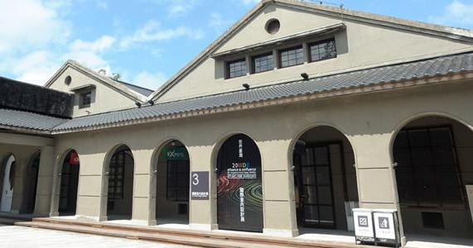
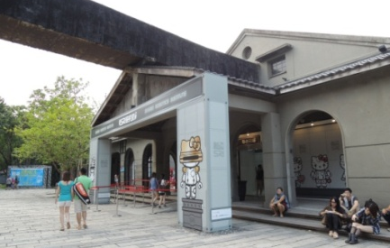
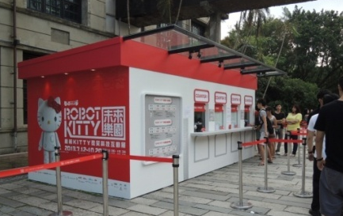
Songshan Cultural and Creative Park https://www.songshanculturalpark.org/cms/en/index.aspx
This site was once home to the first modernized tobacco Factory in Taiwan, which created tremendous economic value to the nation. On November 15th, 2011, after it officially opened to the public, it has now been transformed into a creative hub of Taiwan.
The Multi-Showcase Exhibition Hall is a spacious venue that can be used for diverse cross-disciplinary presentations.
The No. 1-5 Warehouses and Conveyor Belt were built in 1940 and its continuous archways are one of the building’s distinctive features. The No. 1 warehouse is a solitary building and takes up the area of 440 ping (approximately 1454 m2). No. 2 to 5 warehouses are connected units, with No. 2 and No. 3 interconnected with each other. No. 4 and No. 5 warehouses were used as flat open storage spaces, which make them ideal for presenting various exhibitions and artistic events. The warehouse’s capacity could be fully utilized, and its interior is free of supportive columns. Fortification façade walls have been implemented on the outer walls of No. 2 and No. 5 warehouses to form extra support for the architectural structure.

Slide 15
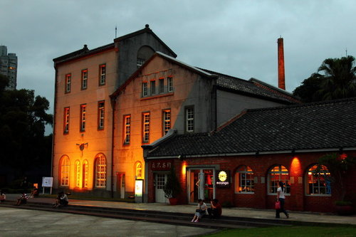
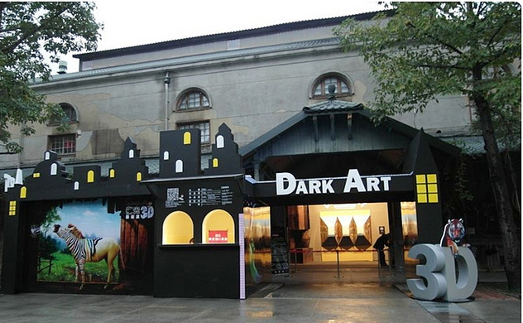
Huashan 1914 Creative Park https://www.huashan1914.com/w/huashan1914_en/Index
In 1999, the Association of Culture Environment Reform Taiwan, a non profit NGO, was established to oversee the restoration of the factory into a full fledged arts center. The factory was renamed the Huashan Creative Park and, in 2005, the rebuilding of the Creative Park officially began. In 2007, the Taiwan Cultural-Creative Development Co. Ltd assumed responsibility for the renovation and operation of the Park and renamed it Huashan 1914.
Huashan 1914 now serves as Taipei’s primary creative arts center and a hosting ground for Taiwan’s most significant cultural events.
It is a suitable exhibition ground which houses t 4-connected buildings, with a capacity of 2,562sqm.

Slide 16
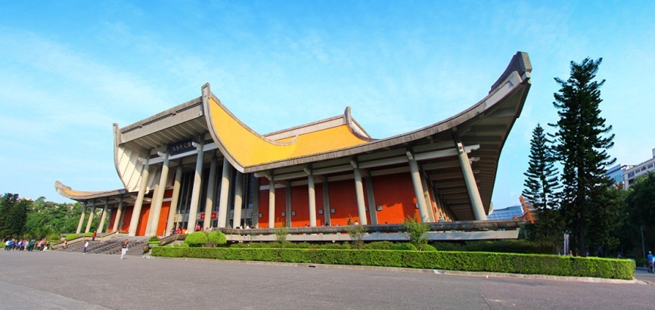
National Dr. Sun Yat-sen Memorial Hall
https://www.yatsen.gov.tw/en
Sun Yat-Sen Memorial Hall serves as a place of remembrance for all to emulate the national founding father – Dr. Sun Yat-sen, but also encompasses the functions of cultural and artistic education, leisurely recreation and academic research. When it was first inaugurated, the memorial hall was primarily used for exhibiting Dr. Sun Yat-sen’s revolutionary artifacts and also hosted some of the exhibitions and performances.
Currently, it serves as a multifunctional, social educational and cultural center. It houses an internationally renowned national performance hall, expansive elegant and aesthetic exhibition venues measuring several tens of thousand square feet, projection room with innovative setup, lecture hall, Chung Shan lecture hall, professional library with more than 40,000 collection of books, as well as the tranquil and titillating Emerald Pond exhibition/performance area and Chung Shan Park.

Slide 17
Location of Major Venues – Mid Taiwan

Slide 18
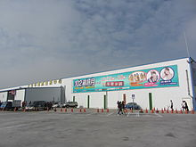
Greater Taichung International Expo Center
http://edn.udn.com/gti/en/index.html
With events for the next 15 years already scheduled, the center is highly sustainable
In addition to the 811 booths in the regular venues, another 7,000sqm of temporary exhibition hall space is available
In addition to the 7,500 parking spaces near the center, the nearly 7-hectare parking area belonging to the Bureau of High Speed Rail is available.
The Exhibition center has a total 11,571 sqm floor space and can house 803 standard booths.

Slide 19
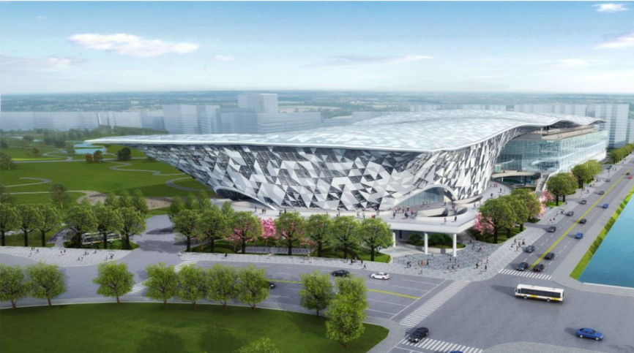
Shuinan International Convention and Exhibition Center
http://www.shuinanicec.com.tw/index.aspx
Scheduled to completed at the end of 2022, the Shuinan International Convention and Exhibition Center has the capacity to host 2,360 standard-size (3x3meters) booths and 12,600 seats for conference.
• It will be connected to the Greater Taichung International Expo Center, create Taichung City to become an international convention and exhibition city and promote industrial development in the central region.

Slide 20
Location of Major Venues – South Taiwan

Slide 21
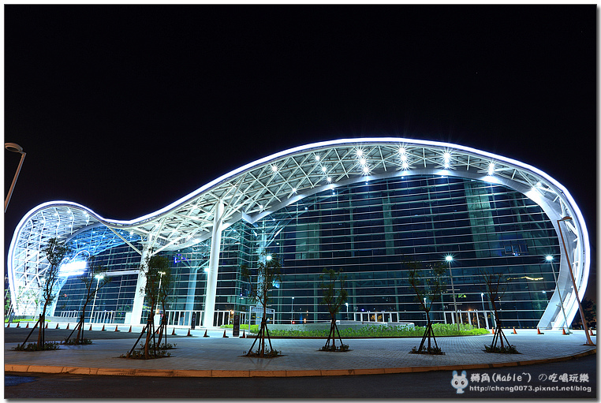
Kaohsiung Exhibition Center (KEC)
http://www.kecc.com.tw/
Opened in 2014, Kaohsiung Exhibition Center (KEC) is the first multifunctional waterfront venue for exhibitions, international conferences, association meetings, banquets, concerts, product launches as well as outdoor events in Taiwan. This central government investment has accelerated the development of the MICE industry in the midst of the important markets and industrial clusters of South Taiwan.
Thanks to strong investment in its New Bay Area, Kaohsiung, Taiwan’s 2nd largest city and premier trading port, is rapidly transforming into a vital city destination in a delightful subtropical setting, making it a fantastic choice for combining business and leisure in Asia.
With over 25,000 m2 of indoor and outdoor exhibition space and large variety of conference rooms accommodating between 20 to 2,000 people, with a capacity of up to 4,000 attendees at one time, KEC is the premier multi-purpose venue in Taiwan, ideal for hybrid events.

Slide 22
Exhibition Facts and Figures

Slide 23
General Information
Who are typically the organizers (local? international?)
Organisers are usually from the Bureau of Foreign Trade, implemented by TAITRA. However, there are also other professional exhibition organisers from various associations.
Which services are typically handled by the organizers and which can you subcontract?
Organisers usually plan and attract exhibitors, while other services such as official construction, advertising, media & publicity can be subcontracted
Are there unions to be dealt with? If so, who and where? No.
Information on Rigging? Only Kaohsiung Exhibition Center allows rigging.
How are move in/move outs handled (lots of time? No time? Targeted move ins or outs? The move in time varies with different organisers. Move in typically takes 2-6 days, while move out takes is 1-2 days.
Health and Safety standards? Some countries (like the UK) require detailed Risk Assessments and Method Statements, for example. For structures that are over a certain height limit or double storey structures, we are required to submit insurance and architectural assessments.
Building permissions? Yes, we need to apply during the move in period.

Slide 24
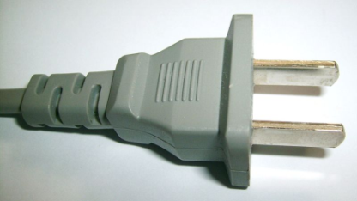
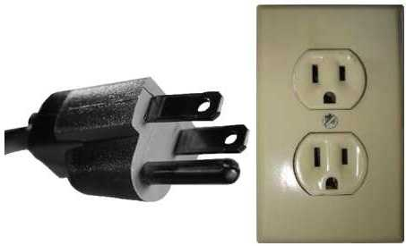
Electrics and Electricity
Typical Voltage (110/220v)?
Typically we use 110V, but 220 V is also available in Taiwan
Do you need to have certified electricians?
Yes
What are the standard plugs and sockets
NEMA 1–15 (typical)
NEMA 5–15

Slide 25
Labour Cost Estimates
General Labourer: $60-$80 / 8 hours(9:00-17:00)
Experienced Labourer: $120-$140 / 8 hours(9:00-17:00)
Site Supervisors: $125-$165 / 8 hours(9:00-17:00)
Custom Stand Builders: $120-$140 / 8 hours(9:00-17:00)
Rates are based on regular hours, Monday to Friday, excluding weekends, public holidays and overtime.

Slide 26
Materials Usage
Carpet - standard types, rough prices?
Non-woven, $5/SQM
Raised flooring—standard or not standard? Heights? Materials? Costs?
We do not use raised flooring.
Standard US materials available in your country? Names or equivalencies could be good (Sintra is similar to Forex in Germany, for example.
Plywood (similar to MPF), Acrylic (similar to Plexi-glass), Forex Board (similar to Sintra)
In your experience, are any materials particularly cheaper or more expensive in your country as compared to the US?
Materials are usually cheaper in Taiwan, but we may still need to import other materials which will be more costly.

Slide 27
Shopping Tips
An example of a Home Improvement store where construction things can be bought (hardware, tools, paint, etc.) Home Depot or Lowes in the states
B&Q (I-House) , http://www.i-house.com.tw/
Home Box, http://www.homebox.com.tw/
An example of an electronics store for cables, monitors, etc. Best Buy or Fry’s in the States
Guang Hua Computer Market, http://www.gh3c.com.tw/index.php
TK 3C, https://www.tk3c.com.tw/
A general sort of store where everything can be bought, a Walmart or Target type of store
Costco, https://www.costco.com.tw/front
Carrefour, http://www.carrefour.com.tw/
RT-Mart, https://news.rt-mart.com.tw/main
Is IKEA available, if not, something similar?
IKEA Taiwan, https://www.ikea.com.tw/zh
Hola, https://www.trplus.com.tw/Hola
27

Slide 28
EDPA International Members
Active in this country
Uniplan
28

Slide 29


