Slide 1


EDPA International/IFES
Country Report - Vietnam
A Local Knowledge Report
From Exhibit/Event Service Providers
Vietnam

Slide 2

Updated on 30 Oct 2019
Presentation Prepared By
Kingsmen Vietnam Co. Ltd
Ho Chi Minh City office
15th Floor, Harbour View Tower, 35 Nguyen Hue Street, Ben Nghe Ward, District 1, Ho Chi Minh City, Vietnam
Hanoi office,
5th Floor, Viet Tower, 01 Thai Ha Street,
Trung Liet Ward, Dong Da District, Hanoi

Slide 3
Vietnam Facts and Figures

Slide 4
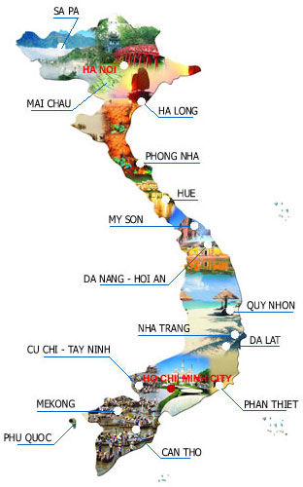
Facts & Figures
Population 96,462,106
Main language(s): Vietnamese
Country Size: 331,212 km²
GDP(PPP): 2019 estimate
  Total: $769.928 billion
  Per capita: $8,063 per annum
Capital City, population:
Hanoi – 8,053,663
Largest City, population:
Ho Chi Minh City – 8,993,082
Notes:
https://en.wikipedia.org/wiki/Vietnam
http://worldpopulationreview.com/countries/vietnam-population/
https://vi.wikipedia.org/wiki/Thành_phố_Hồ_Chí_Minh

Slide 5
Money Issues
What is the standard currency? What is a standard conversion rate?
  đồng (₫) (VND)
  1 USD = 23,265 VND (According to VIETCOMBANK - Joint Stock Commercial Bank for Foreign Trade of Vietnam)
Are credit cards widely accepted? Should the traveller plan on dealing with lots of cash?
  Credit cards are commonly accepted used in hotels, restaurants and shopping centres. Elsewhere, cash is required (Vietnam has the one of the lowest cashless transaction rates in ASEAN)
Are credit cards required (like in the US at shows for services)?
  Credit cards are optional (the same at exhibition shows)
Hints regarding tipping (taxis, restaurants, bars, baggage handlers, etc.) and/or haggling?
  In general, tipping is not mandatory but it is common in Ho Chi Minh City. In certain restaurants & bars, tip is specified and added in the bill. (about 5% - service fee)
  Is there a VAT? How high is it? Who needs to pay it? Is there a way for Americans to get it refunded? Is there a useful website (in English)?
  Yes, VAT = 10% of the cost. Customers need to pay VAT. Tourists can get their refunds at the airport by showing the airport tax return department their tax invoices. However, not all vendors issue tax invoices. Customers need to check with the store before purchase.
Notes:
https://e.vnexpress.net/news/business/data-speaks/vietnam-cashless-transactions-among-lowest-in-asean-3921949.html

Slide 6
Size and Distance Information

Slide 7
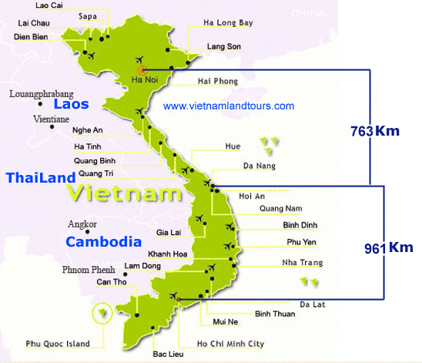
1 hour
(by plane)
2 hours
(by plane)
1 hour
(by plane)
1.724 Km

Slide 8
Location of Major Venues

Slide 9
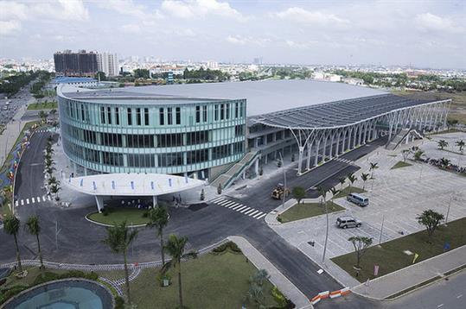
Saigon Exhibition & Convention Center (SECC)
http://secc.com.vn/
Address: 799 Nguyen Van Linh Street, Tan Phu Ward, District 7, Ho Chi Minh City
The SECC is the largest, the most modern Exhibition & Convention Center of the South of Vietnam, and only 15 minutes from the centre of Ho Chi Minh City, 30 minutes from Tan Son Nhat International Airport.
Function: national and international conventions, large scale public and trade exhibitions, corporate meetings and specialized events indoors and outdoors.
Facilities: (now – 1st phase of total project construction)
A column-free exhibition hall with 9.000 square meters for up to 465 booths,
Outdoor exhibition areas of 6.000 square meters,
Conference hall (500-seat), meeting rooms
(100-seat & 20-seat),
Cafeteria (200-seat) and restaurant (500-seat),
Parking lot for maximum of 500 cars and 1,300 motorcycles.
In the future, SECC will comprise four indoor exhibition halls totaling to 40,000 square meters, additional outdoor exhibition space of 15,000 - 20,000 square meters, one 2,000-seat convention center, one high-rise office tower, and two international standard hotels (a 4-star one with 600 rooms and a 5-star one with 400 rooms).Underground parking is adopted.
Right now, SECC is building the 2nd Exhibition hall.

Slide 10
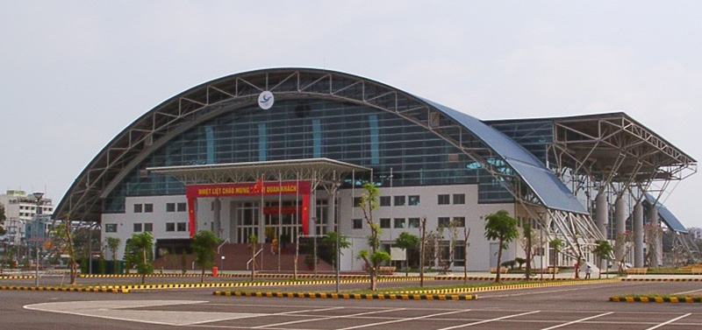
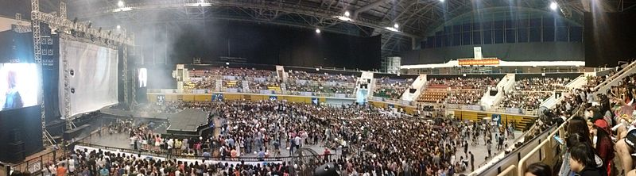
Phu Tho Sport Stadium
http://www.thethaophutho.vn
Address: 219 Ly Thuong Kiet Street, Ward 15, District 11, Ho Chi Minh City
Only 15 minutes (7 km) from the centre of Ho Chi Minh City, 15 minutes (7km) from Tan Son Nhat International Airport.
Function: Sports activities, fairs, exhibitions, customer conferences, music shows, fashion and gymnastics competitions.
Owner: Ho Chi Minh City Department of Culture, Sports and Tourism
Capacity (total area of 46,000m2)
22,000m2 of construction floor (130m x 105m)
A full-house capacity of around 8,000
A capacity of 5,000 people for sporting events
The height of the roof is 31m
Inside Phu Tho Sport Stadium during 2NE1 Galaxy Stage (2NE1 - one of the most successful girl groups in South Korea). Moreover, this venue was held for Miss Vietnam 2016, 2018; Asian Taekwondo Championships 2018; AFF Futsal Championship 2005 – 2017; Asian Indoor Games 2009; Southeast Asian Games 2003

Slide 11
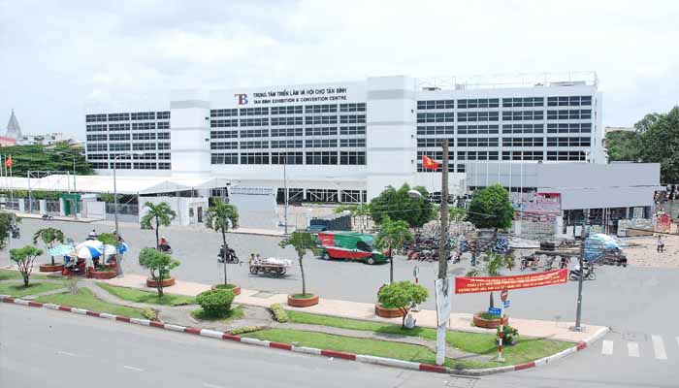
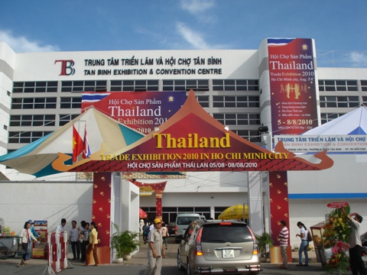
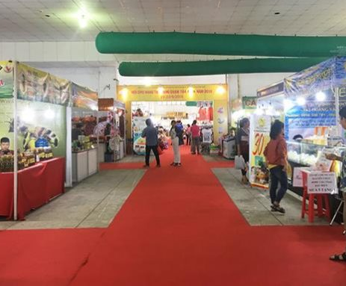
Tan Binh Exhibition & Convention Center (TBECC)
https://www.facebook.com/HoiChoTrienLamTanBinh/
Address: 446-448 Hoang Van Thu Street, Ward 4, Tan Binh District, Ho Chi Minh City
Only 18 minutes (7 km) from the centre of Ho Chi Minh City, 12 minutes (4 km) from Tan Son Nhat International Airport.
Used to hold many large exhibition shows 3-4 years ago but recently serves as an affordable only small or medium-scale shows due to the old building and opening of new, well-equipped venues.
Function: trade events, shows, exhibitions, seminars, meetings & conventions.
Facilities:
7000 sqm indoor area
2000 sqm outdoor area

Slide 12
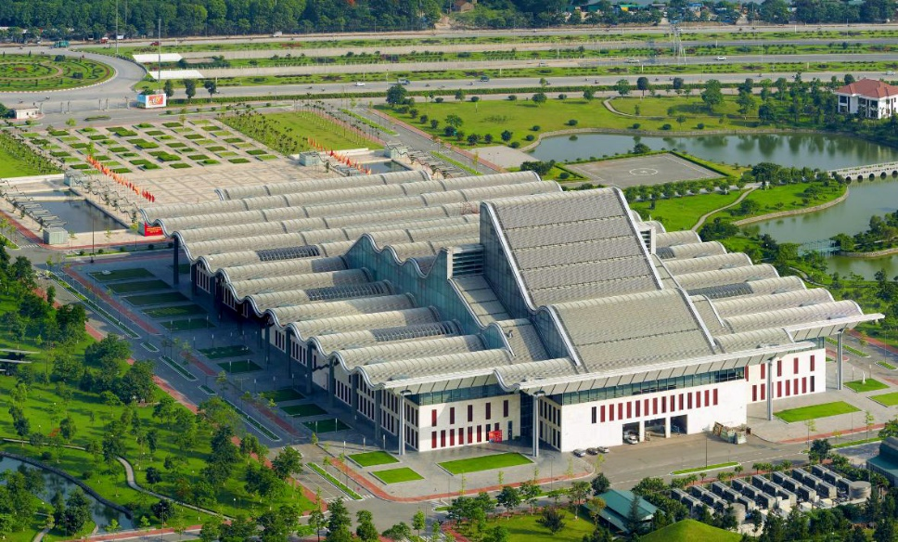
National Conference Center Of Vietnam (NCC)
http://ncc.gov.vn/
Address: Gate 1, Thang Long Avenue, Me Tri Ward, Nam Tu Liem District, Hanoi
The Center is located at the intersection of Thang Long Avenue and Pham Hung Road, 10 km from the center of Hanoi and 40 km from Noi Bai Airport.
NCC is the leading and largest conference center in Vietnam. This complex includes a public square, a helipad, an on-ground and underground parking lot of 1,100 parking spaces, residential area and landscaping features.
Suitable for: International and domestic exhibitions, art performances, physical training and sports activities, social-political activities; meetings, weddings, roadshow, festivals.
VNCC has hosted many high-profile political events. Some of the significant events include: 2006 APEC Economic Leaders' Meeting; 16th ASEAN Summit (2010); National Congress of the Communist Party of Vietnam (2011,2012)
Facilities: (64 ha)
4,389 sqm indoor area
1,500 sqm outdoor area
15,000 m² (160,000 sq ft) exhibition space
Banquet Hall, accommodating up to 1,800 people, 2,000 m² (22,000 sq ft)
Main Meeting Hall, 3,747 seats with a divider for a smaller configuration, 4,256 m² (45,810 sq ft)
1 executive ballroom
2 executive meeting halls
3 press and media rooms
24 meeting rooms/ 72 breakouts

Slide 13
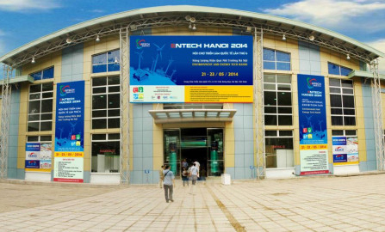
Hanoi International Center for Exhibition (ICE)
http://icehanoi.vn/
Address: 91 Tran Hung Dao Street, Hoan Kiem District, Hanoi
Right inside the centre of Hanoi, 40 minutes (30 km) from Noi Bai International Airport.
Most popular exhibition venue in North of Vietnam. Nearby government facilities and easy access to public transport. Next to the Vietnam-Soviet Friendship Labor Culture Palace (musical theatre).
Suitable for: International and domestic fairs, art performances, physical training and sports activities, social-political activities; meetings, weddings.
Facilities:
Currently being rented out by VEFAC until VEFAC complete building up new exhibition center estimated to be in the end of 2020.
4,389 sqm indoor area
1,500 sqm outdoor area
Notes:
https://10times.com/venues/hanoi-international-center-for-exhibition-ice-hanoi

Slide 14

Vietnam Exhibition Fair Center (VEFAC)
http://www.vefac.vn/
In Hanoi. Not built yet. In Plan
VEFAC has been selected by the Government as the Investment owner of a mega development project to create a versatile, advanced National Exhibition Center. The project includes two independent component projects:
1. The first component project is the National Exhibition Fair Center Project at Nhat Tan road to Noi Bai airport.
2. The creation of the National Exhibition Center over an area of 125.9 hectares in Me Tri, Tu Liem, Hanoi
3. The establishment of a Trade, Service and Culture Center over an area of 6,838 hectares in Giang Vo, Ba Đình, Hà Nội.

Slide 15
Exhibition Facts and Figures

Slide 16
General Information
Who are typically the organizers (local? international?)
  Local: Vinexad, Veas, Adpex, Hien Dat, CIS Viet Nam, Vietfair, Vasep, Vietbuild, Hawa, Vietrade
  International: Informa (Ubm), Reed Tradex, Coex, Fireworks, Atfa, Phoenix, Chanchao
Which services are typically handled by the organizers and which can you subcontract?
  If we are the official contractor of the show, we’ll handle the production of the event and provide Organizer requirement and Additional order items. The scope of work includes designing and building the standard/upgrade/pavilion booths, special design booths, floor marking, backdrop/posters/signages; managing the electricity and furniture for rental.
Are there unions to be dealt with? If so, who and where?
  For exhibition shows held at SECC, it is allowed to use only venue owner in-house supplier for furniture (named TMT); electricity (named Hong Hac); logistics (named Vega)

Slide 17
General Information
How are move in/move outs handled (lots of time? No time? Targeted move ins or outs?
  Handled by either the contractor or subcontractor. These typically take 1 – 3 days, from 9 to 14 hours/day. (8.00-17.00/12.00-22.00/8.00-22.00)
Health and Safety standards? Some countries (like the UK) require detailed Risk Assessments and Method Statements, for example.
  Standard safety and recognition gear for workers (helmets and nametags) are compulsory to enter the venue during set up days.
  According to the venue’s regulation, welding and spray painting are prohibited. Air compressors used during construction needs to be verified and approved by the management.
Building permissions?
  For indoors exhibition construction, builders only require approval from the venue’s management.
  Outdoors exhibition construction requires government approval and approval from the Venue Management.

Slide 18
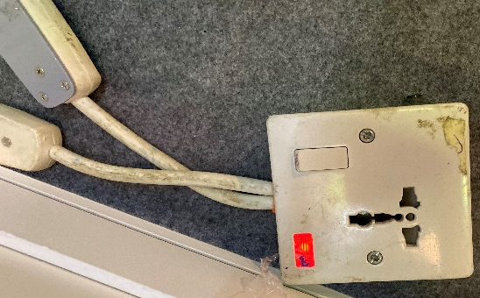
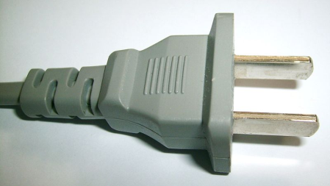
Electrics and Electricity
Typical Voltage (110/220v)?
  220v
Do you need to have certified electricians?
  Yes, we require certified electricians
What are the standard plugs and sockets?
  Here is our standard plug and socket

Slide 19
Labour Cost Estimates
General Labourer: $15 / 8 hrs (8am - 5pm, 1 hr noon rest)
Experienced Labourer: $20 / (8am - 5pm, 1 hr noon rest)
Site Supervisors: $55 / (8am - 5pm, 1 hr noon rest)
Custom Stand Builders: $13/day on average. Actual work hours may vary from the standard 8 hour time slots.
Rates are based on regular hours, Monday to Friday, excluding weekends, public holidays and overtime.

Slide 20
Materials Usage
Carpet - standard types, rough prices?
  Needle punch, $5/sqm
Raised flooring—standard or not standard? Heights? Materials? Costs?
  Platform (100mmH) MDF with steel frame: $15/sqm
Standard US materials available in your country? Names or equivalencies could be good (Sintra is similar to Forex in Germany, for example.
  Our silicone is US standard
In your experience, are any materials particularly cheaper or more expensive in your country as compared to the US?
  Generally cheaper

Slide 21
Shopping Tips
An example of a Home Improvement store where construction things can be bought (hardware, tools, paint, etc.) Home Depot or Lowes in the states
  All tools and materials are sourced from multiple suppliers. Some of these include Kohnan Japan and Dan Sinh Market
An example of an electronics store for cables, monitors, etc. Best Buy or Fry’s in the States
  Nguyen Kim Market, Lotte Mart. Retail Stores near local markets
A general sort of store where everything can be bought, a Walmart or Target type of store
  AEON mall, Big C, Lotte Mart
Is IKEA available, if not, something similar?
  No IKEA available. Similar: Hafele, An Cuong, Rong Phuong Bac, Chi Lai
21

Slide 22
EDPA International Members
Active in this country
22

Slide 23


