Slide 1
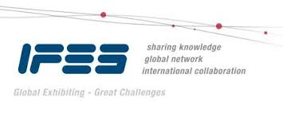

EDPA International/IFES
Country Report Template
A Local Knowledge Report
From Exhibit/Event Service Providers
United Arab Emirates

Slide 2

Presentation Prepared By
Kingsmen Middle East LLC
P O Box 37741
Rais Hassan Saade Building
Plot No. 364-368,
Shed No. 2, Street No. 12A
Al Quoz Industrial Area 1
Dubai, UAE

Slide 3
United Arab Emirates Facts and Figures

Slide 4
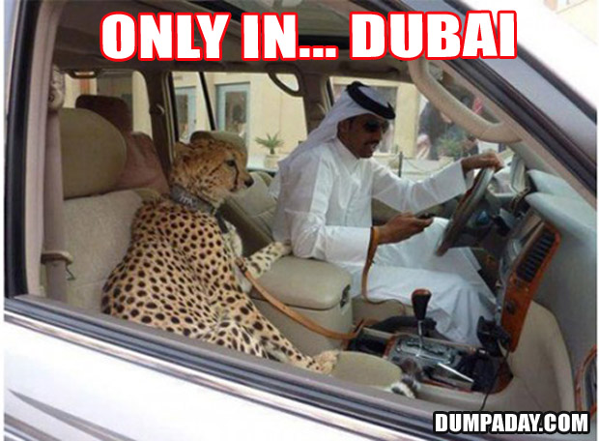
Facts & Figures
Population approx.: 9.4 Million
Main language(s): Arabic
Country Size: 83600 Km Sq.
Other info: Federation of 7 Emirates. Emirates oil reserves are ranked as the seventh largest in the world.
Capital City, population: Abu Dhabi, 896,751
Largest City, population: Dubai, 1,770,533

Slide 5
Money Issues
What is the standard currency? What is a standard conversion rate?
United Arab Emirates Dirhams (AED)
1USD = 3.67 AED
Are credit cards widely accepted? Should the traveller plan on dealing with lots of cash?
Yes, debit/credit cards are widely accepted within the city
Are credit cards required (like in the US at shows for services)?
Yes
Hints regarding tipping (taxis, restaurants, bars, baggage handlers, etc.) and/or haggling?
There isn’t a set of rules for tipping within the city, however in the case of tipping, a standard of 10-15% is followed.
Is there a VAT? How high is it? Who needs to pay it? Is there a way for Americans to get it refunded? Is there a useful website (in English)?
There is no prevalent VAT as yet, however it could be introduced in the near future.

Slide 6
Size and Distance Information

Slide 7
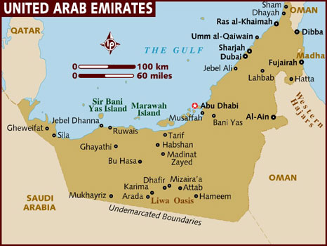
Distance:
34 km
Driving:34 Minutes
UNITED ARAB EMIRATES DRIVING DISTANCES ACROSS THE 7 EMIRATES
ABU DHABI
DUBAI
SHARJAH
UMM- AL-QWAIN
RAS AL-KHAIMAH
FUJAIRAH
AL-AIN
Please note: All distance are shown as per continual driving no stops included.
Distance:
29 km
Driving:34 Minutes
Distance
17 km
Driving:
22Minute
Distance:
113 km
Driving:
02 hours & 8 Minutes
Distance:
143.20 km
Driving: 01 hour & 22Minutes
Distance:
225 km
Driving:3 hours & 9 Minutes

Slide 8
Location of Major Venues

Slide 9
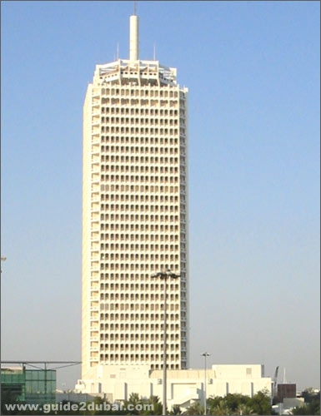
DUBAI WORLD TRADE CENTER
(http://www.dwtc.com/en/Pages/default.aspx#.U8Zzy_mSyCo )
DWTC plays host to more than 500 events across international trade fairs, mega consumer shows and prestigious conventions to 1.8 million visitors from 160 global markets each year.

Slide 10
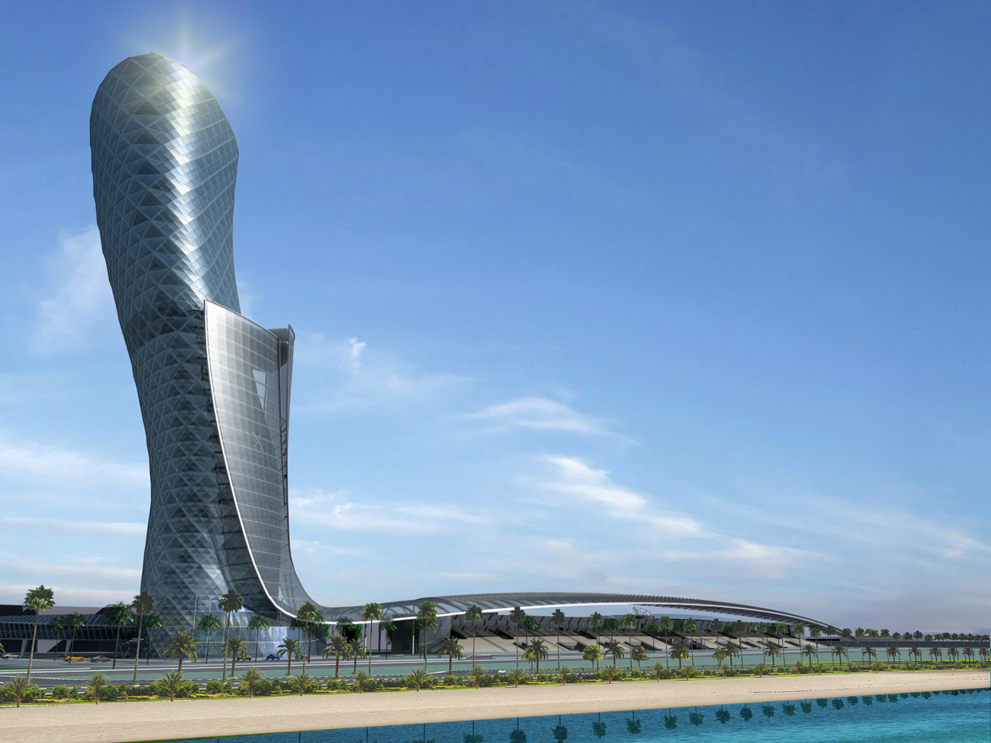
ABU DHABI NATIONAL EXHIBITION COMPANY
(http://www.adnec.ae/ )
ADNEC has 12 halls which offer event organizers an inter-connected and flat-roofed floor space of 73,000sqm.

Slide 11
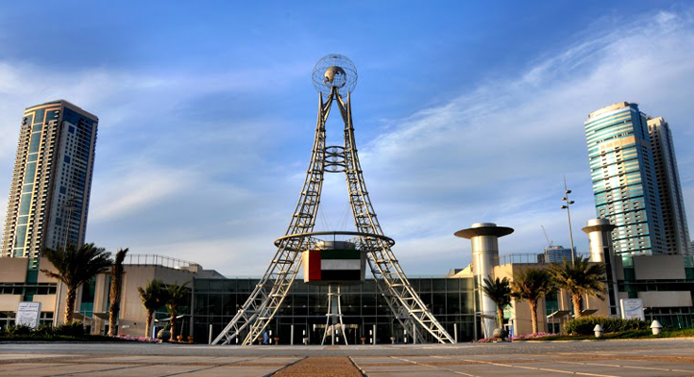
EXPO CENTER SHARJAH
(http://www.expo-centre.ae/en/ )
Since its establishment in 1977, Expo Centre Sharjah has placed the emirate of Sharjah on the map of international exhibitions industry and has been a focal point of international trade since then.
In September 2002, sensing the technological and increasing space demands of its trade partners and customers, Expo Centre Sharjah moved to its present location, where state-of-the-art facilities were added to provide a cutting edge to the Centre.

Slide 12
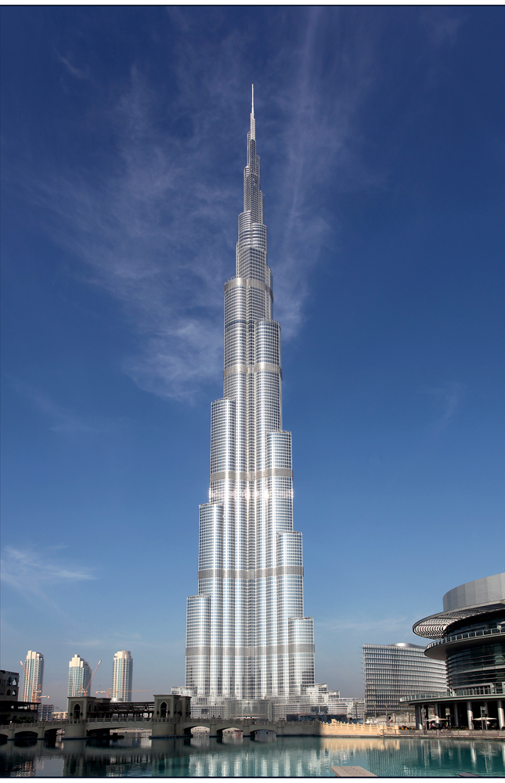
BURJ KHALIFA
(http://www.burjkhalifa.ae/en/ )
Burj Khalifa the world’s tallest building, it has also broken two other impressive records: tallest structure, previously held by the KVLY-TV mast in Blanchard, North Dakota, and tallest free-standing structure, previously held by Toronto’s CN Tower. The Chicago-based Council on Tall Buildings and Urban Habitat (CTBUH) has established 3 criteria to determine what makes a tall building tall. Burj Khalifa wins by far in all three categories.
Burj Khalifa, the world’s tallest building, has also broken two other impressive records: tallest structure, previously held by the KVLY-TV mast in Blanchard, North Dakota, and tallest free-standing structure, previously held by Toronto’s CN Tower. The Chicago-based Council on Tall Buildings and Urban Habitat (CTBUH) has established 3 criteria to determine what makes a tall building tall. Burj Khalifa wins by far in all three categories.

Slide 13
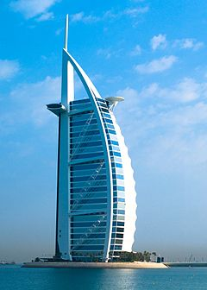
BURJ AL ARAB
(http://www.jumeirah.com/en/hotels-resorts/dubai/burj-al-arab/ )
Burj Khalifa, the world’s tallest building, has also broken two other impressive records: tallest structure, previously held by the KVLY-TV mast in Blanchard, North Dakota, and tallest free-standing structure, previously held by Toronto’s CN Tower. The Chicago-based Council on Tall Buildings and Urban Habitat (CTBUH) has established 3 criteria to determine what makes a tall building tall. Burj Khalifa wins by far in all three categories.

Slide 14
Exhibition Facts and Figures

Slide 15
General Information
Who are typically the organizers (local? international?)
A mix of both
Which services are typically handled by the organizers and which can you subcontract?
Organiser - Organiser requirements
Subcontract - Registration counters, direction signages, banners & joinery works
Are there unions to be dealt with? If so, who and where?
Venue owners, municipality or local authorities
Information on Rigging?
Rigging from venue
How are move in/move outs handled (lots of time? No time? Targeted move ins or outs?
Move ins take 2-3 days, while move outs happens right after the closing of the show till the morning after
Health and Safety standards? Some countries (like the UK) require detailed Risk Assessments and Method Statements, for example.
It is a requirement from clients & some venue owners. (HSE Assessment & Method Statement)
Building permissions?
For each setup, design approval is required before moving in.

Slide 16
Electrics and Electricity
Typical Voltage (110/220v)?
220-240 V
Do you need to have certified electricians?
Yes
What are the standard plugs and sockets
3 Pin Socket and 3 Pin Top.
Universal Sockets are also used.
- http://www.elitco.com/products-list-default/9/319/switches-and-sockets (CHINA MADE)
- http://www.mkelectric.com/en-gb/Products/WD/logicplus/socketoutlets/Pages/default.aspx (ENGLAND MADE)

Slide 17
Labour Cost Estimates
General Labourer: $70 - $90/ 8 hours (9:00 – 17:00)
Experienced Labourer: $110-$150/ 8 hours (9:00 – 17:00)
Site Supervisors: $200-$220/ 8 hours (9:00 – 17:00)
Custom Stand Builders: $200-$220/ 8 hours (9:00 – 17:00)
Rates are based on regular hours, Sunday to Thursday, excluding weekends, public holidays and overtime.

Slide 18
Materials Usage
Carpet - standard types, rough prices?
Both standard & exclusive carpet types are available. Prices are reasonable and subjected to negotiation, $13.50/- per sqm onwards
Raised flooring—standard or not standard? Heights? Materials? Costs?
Standard raised flooring with a height of 100 mm, plywood
Shaw Floors ( http://shawfloors.com/carpet/viewall) (US MAKE) $32.40 – $81 PER SQM.
Interface Carpets (http://www.interfacemiddleeast.com/webapp/wcs/stores/servlet/ProductSearch?storeId=10001)
Standard US materials available in your country? Names or equivalencies could be good (Sintra is similar to Forex in Germany, for example)
Yes – subject to timelines of the project and quantity required
In your experience, are any materials particularly cheaper or more expensive in your country as compared to the US?
There are no taxes and less import duty. However, the price depends on the quantity, delivery schedules and stock availability.

Slide 19
Shopping Tips
An example of a Home Improvement store where construction things can be bought (hardware, tools, paint, etc.) Home Depot or Lowes in the states
ACE hardware and Total solutions, Ikea, Speedex (http://www.aceuae.com/content/default.aspx )
An example of an electronics store for cables, monitors, etc. Best Buy or Fry’s in the States
Emax, Sharaf Dg and Jumbo (http://www.sharafdg.com/)
A general sort of store where everything can be bought, a Walmart or Target type of store
Carrefour and Union Co-op (http://www.carrefouruae.com/ & http://www.ucs.ae/ucs/home.aspx )
Is IKEA available, if not, something similar?
Yes, IKEA is available in Dubai
19

Slide 20
EDPA International Members
Active in this country
20

Slide 21


