Slide 1


EDPA International/IFES
Country Report Template
A Local Knowledge Report
From Exhibit/Event Service Providers
Thailand

Slide 2

Presentation Prepared By
Kingsmen C.M.T.I. Plc.
9/19 Moo 7, Lam Luk ka Leab Khlong 6 Road,
Bueng Kham Proi Sub-district,
Lam Luk ka District,
Pathum Thani 12150, Thailand

Slide 3
Thailand - Facts and Figures

Slide 4
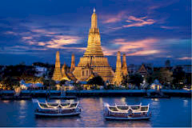
Facts & Figures
Population approx: 69.3 million
Main language(s): Thai
Country Size: 513,120 km²
Capital City: Bangkok, Population: 8.28 million
Largest city: Bangkok
Wat Arun, Bangkok, Thailand

Slide 5
Money Issues
What is the standard currency? Thai Baht What is a standard conversion rate? 1 USD = 30 THB
Are credit cards widely accepted? Should the traveller plan on dealing with lots of cash? Yes, international hotel chains and larger businesses in Thailand accept major credit cards.
Are credit cards required (like in the US at shows for services)? Yes
Hints regarding tipping (taxis, restaurants, bars, baggage handlers, etc.) and/or haggling? Tipping -- If no service charge is added to your check at a fine-dining establishment, a 10% - 15% tip is appropriate.
Is there a VAT? How high is it? Who needs to pay it? Is there a way for Americans to get it refunded? Is there a useful website (in English)? Hotels typically charge 7% VAT and a 10% service charge. Smaller hotels quote prices that are inclusive of these charges. www.bot.go.th

Slide 6
Size and Distance Information

Slide 7
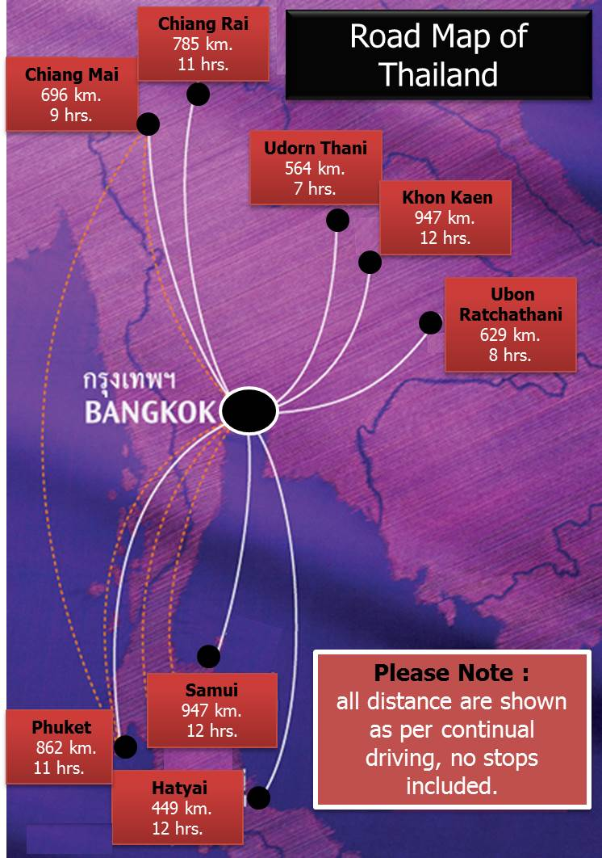
These distances and driving hours are based from Bangkok (capital city) to other major cities within Thailand.
Useful website: http://www.guidetothailand.com/map-thailand/map-distance.php

Slide 8
Location of Major Venues

Slide 9
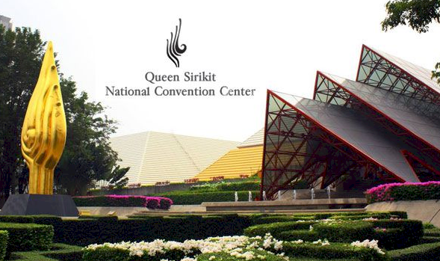
Queen Sirikit National Convention Center (QSNCC)
http://www.qsncc.com/
With 65,000 sqm. of space, the Center is ideal for conferences of up to 5,000 delegates and exhibitions of up to 900 booths
Located in central Bangkok
Opened in 1991
Design: Sophisticated “Thai Hi-Tech” style

Slide 10
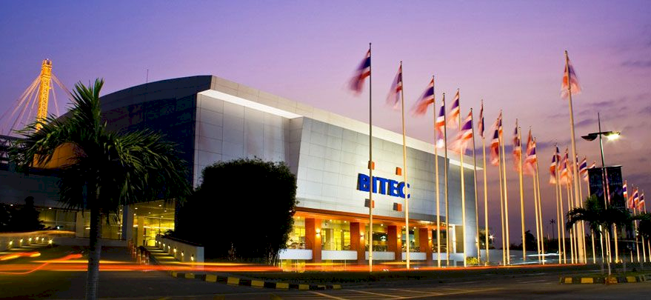
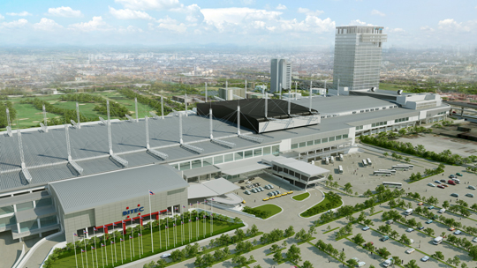
Bangkok International Trade & Exhibition Centre
(BITEC)
http://www.bitec.co.th
Spacious area for events with column-free halls totaling 50,400 sqm of usable space
The land area was increased to 68 acres (272,000 sq.m.), extending parking capacity to 4,700 vehicles
BITEC Phase II and BHIRAJ TOWER at BITEC will be ready by 2016

Slide 11
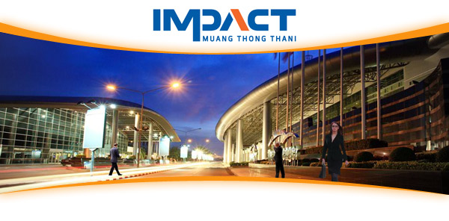
IMPACT Arena, Exhibition and Convention Center
www.impact.co.th/
IMPACT Arena, Exhibition and Convention Center is one of Asia’s largest and most modern exhibition and convention center, with a usable indoor space of over 140,000 sqm.

Slide 12
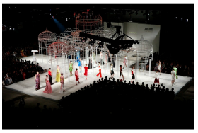
Royal Paragon Hall
www.royalparagonhall.com/
The venue consists of 3 main halls, 6 breakout rooms, VIP room and a backstage area that can be used for various functions
12,000 sqm.
Car Park with over 4,500 indoor parking spaces

Slide 13
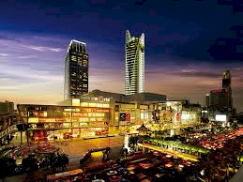
Centara Grand & Bangkok Convention Centre at CentralWorld
https://www.centarahotelsresorts.com/centaragrand/cgcw/
Shopping mall space: 50,000 sqm
5 Star hotel space: 90,000 sqm with 500 rooms
Convention hall space: 17,000 sqm
Car Park: Over 7,000 indoor parking spaces

Slide 14
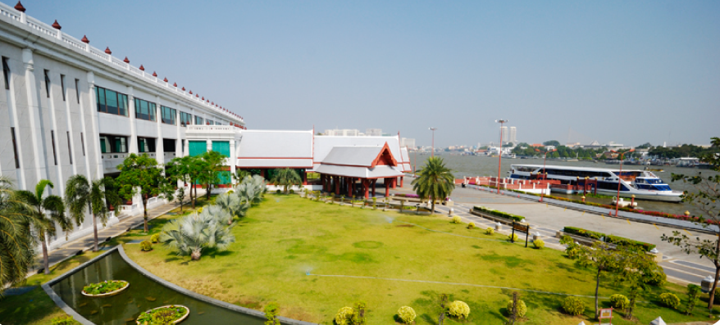
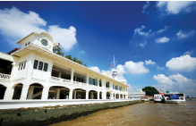
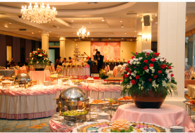
Royal Thai Navy Convention Hall
www.navyhall.com
Has a unique location on the west side of the Chao Phraya River in Bangkok.
It offers an extravagant view of both the Chao Pharya River and the Grand Palace - two of the most visited tourist locations in Bangkok.
The convention hall has over 14,184 sqm of floor space within the main hall. It also features an outer terrace and a garden area along the banks of the Chao Phraya River, giving meetings, receptions and banquets a unique setting.
Equipped with a full range of meeting facilities

Slide 15
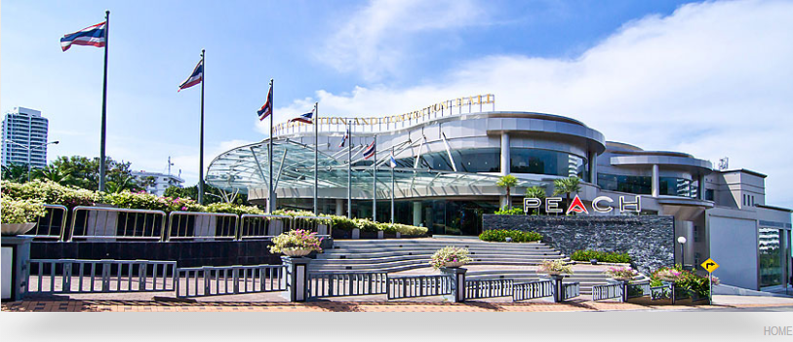
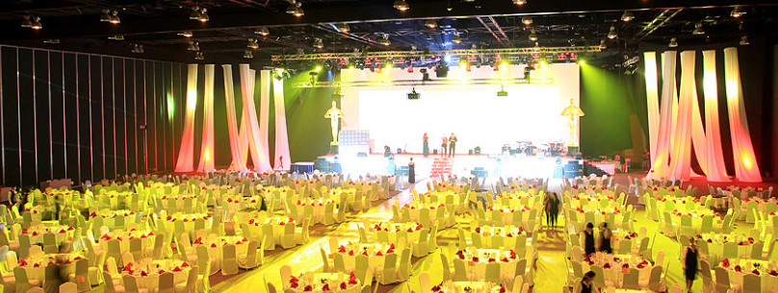
PATTAYA EXHIBITION AND CONVENTION HALL (PEACH)
http://www.peachthailand.com/
Column free halls, which are ideal for automobile and product launches, exhibitions, concerts, gala events and meetings for up to 10,062 delegates.
18 breakout rooms for smaller meetings and functions
Vehicle and display material access from ground level into the main hall
Floor loading: 2.5 tons per square metre (Hall A, B & C), 1.0 tons per square metre (Hall D)
495 recess floor boxes (6 metres apart) with power, water, telecommunication and gas outlets
Sufficient space for 474 booths (3x3m)
Ceiling height of 9.5 m.

Slide 16
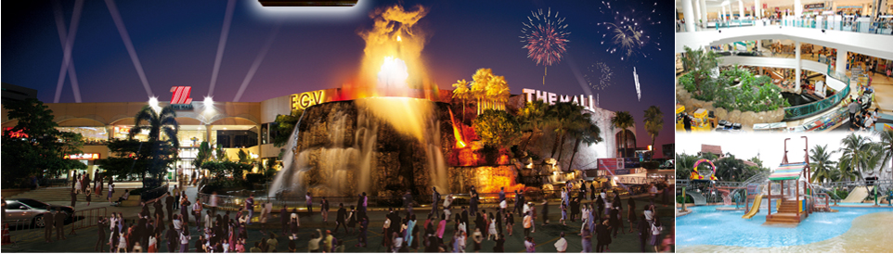
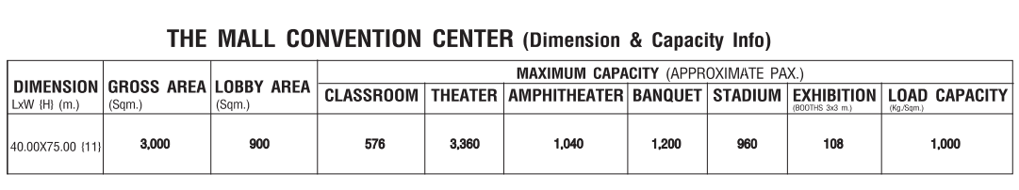
MCC Hall The Mall Korat
http://www.mcchall.themallgroup.com/floorplan.php

Slide 17
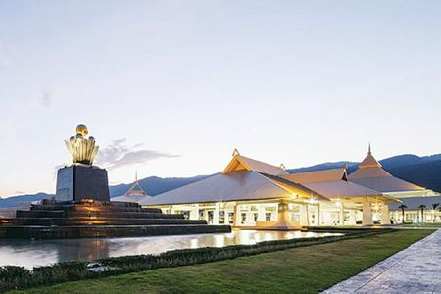
Chiangmai International
Convention & Exhibition Center(CMECC)
http://www.cmecc-mice.com
Usable space of 60,000 sqm.,
Modern facilities and professional services.
It is an ideal location to host world-class international conventions exhibitions, fairs and MICE events.
The main exhibition and convention hall is a large two story building that consists of three main service areas, three connecting exhibition halls, a large convention hall and 29 meeting rooms.

Slide 18
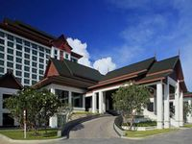
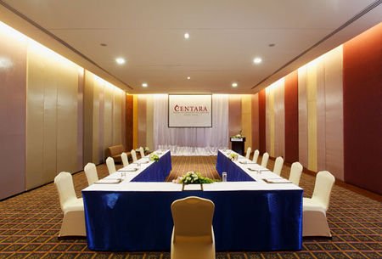
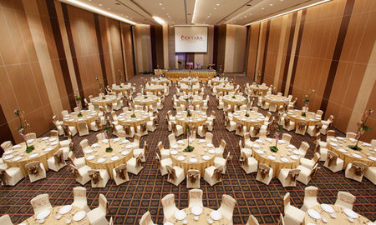
AVANI Khon Khen Hotel & Convention Centre
https://www.avanihotels.com/th/khon-kaen
Four-star hotel offering a distinctive design; combining traditional Isaan influence with modern décor.
The hotel provides easy access to Khon Kaen’s largest shopping and lifestyle centre, Central Plaza Khon Kaen
It is near the Bung Tung San Health Park
15-minutes drive from Khon Kaen Airport.

Slide 19
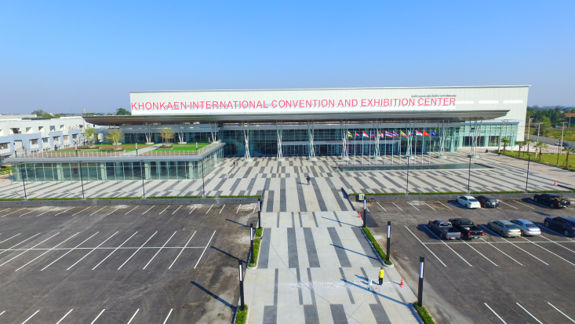
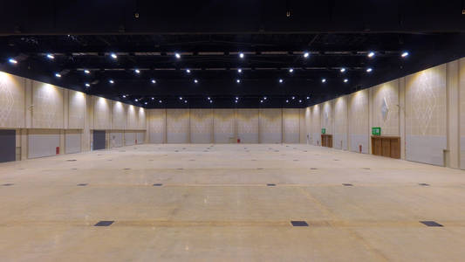
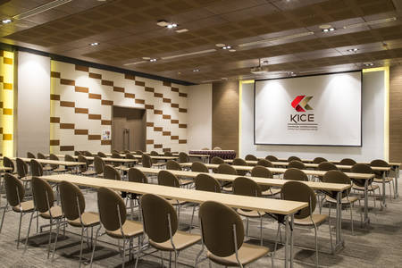
KHONKHEN INTERNATIONAL CONVENTION & EXHIBITON CENTRE
https://www.kice-center.com
KICE is one of most comprehensive versatile MICE venue in Northeastern region of Thailand. Our long-span mega structure enable 7,510 sq.m for indoor and 4,680 sq.m for outdoor.
Main exhibition hall is versatile. It can cater to all types of event, ranging from heavy industrial exhibitions to meetings and convention or live music performance international bands.

Slide 20
Exhibition Facts and Figures

Slide 21
General Information
Who are typically the organizers (local? international?):
Both local and International
Which services are typically handled by the organizers and which can you subcontract? It depends on the scope of the project.
Handled by organizers :
Theme of the overall event
Venue
Managing the budget
PR Plan
Handle by Kingsmen C.M.T.I. :
Eg.: we create and propose the suitable mood, vibe and activities for presentation to the organisers.
Contact the venue’s management and manage site plans. Eg: doing up a floor plan of the event’s functional area
Managing the budget
PR Sessions for pre-event, during the event and post event.

Slide 22
General Information
Are there unions to be dealt with? If so, who and where?
Yes, The Thai Labour Union. The Thai law allow employees to form unions and set requirements for forming a union. At least ten employees at a “business location” can elect to form a union and obtain approval from the Ministry of Labour for the formation of the union. http://www.pricesanond.com/knowledge/thai-labour-unions.php
How are move in/move outs handled (lots of time? No time? Targeted move ins or outs?
Move in typically takes about 2-3 days, while move out is done right after the closing of the show.

Slide 23
General Information
Health and Safety standards? Some countries (like the UK) require detailed Risk Assessments and Method Statements, for example.
Thailand practices the international labour standards
http://www.ilo.org/safework/industries-sectors/WCMS_219015/lang--en/index.htm

Slide 24
General Information
Building permissions?
For special stand constructions, detailed drawing of elevations, layouts, electrical
plans and perspective with dimensions of the stand, including materials used
must be submitted to the organiser and venue management for approval.

Slide 25
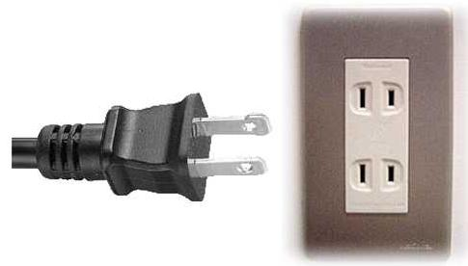
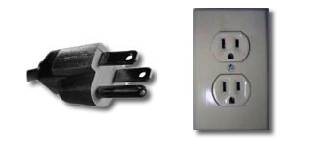
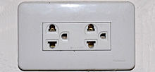
Electrics and Electricity
Typical Voltage (110/220v)?
220-240AC, 50 Hertz.
Do you need to have certified electricians?
Yes
What are the standard plugs and sockets
http://en.wikipedia.org/wiki/Mains_electricity_by_country

Slide 26
Labour Cost Estimates
General Labourer: $20 / 8 hours(9:00-17:00)
Experienced Labourer: $30 / 8 hours(9:00-17:00)
Site Supervisors: $45 / 8 hours(9:00-17:00)
Custom Stand Builders: $50 / 8 hours(9:00-17:00)
Rates are based on regular hours, Monday to Friday, excluding weekends, public holidays and overtime.

Slide 27
Materials Usage
Carpet - standard types, rough prices?
- Needle punch carpet, $6/SQM
Raised flooring—standard or not standard? Heights? Materials? Costs?
- Standard, plywood, 100 mm.
Standard US materials available in your country? Names or equivalencies could be good (Sintra is similar to Forex in Germany, for example.
- Eg.: Laminate: Armstrong, Pergo, Captain Coating
In your experience, are any materials particularly cheaper or more expensive in your country as compared to the US?
- Imported materials are more expensive

Slide 28
Shopping Tips
An example of a Home Improvement store where construction things can be bought (hardware, tools, paint, etc.) Home Depot or Lowes in the states
- http://www.homepro.co.th/
- http://www.indexlivingmall.com/
An example of an electronics store for cables, monitors, etc. Best Buy or Fry’s in the States
  - http://www.homepro.co.th/
  - Pantip Plaza in Pratunam, Bangkok
A general sort of store where everything can be bought, a Walmart or Target type of store
http://www.7eleven.co.th/
Is IKEA available, if not, something similar?
Yes, IKEA is available in Thailand.
- https://www.ikea.com/th
28

Slide 29
Shopping Tips
List of Top Ten Popular Shopping Malls in Thailand:
1. Siam Paragon, Siam
2. CentralWorld, Chidlom
3. MBK Center, Siam
4. EmQuartier, Phrom Phong
Central Embassy Shopping Mall, Ploenchit
Siam Discovery, Siam
Siam Center, Siam
Terminal 21, Sukhumvit Road (Asok)
Platinum Fashion Mall, Pratunam
Pantip Plaza, Pratunam
http://www.bangkok.com/top10-shopping-malls.htm

Slide 30
EDPA International Members
Active in this country
30

Slide 31


