Slide 1


EDPA International/IFES
Country Report Template
A Local Knowledge Report
From Exhibit/Event Service Providers
Singapore

Slide 2

Presentation Prepared By
Kingsmen Exhibits Pte Ltd
The Kingsmen Experience
22 Changi Business Park Central 2
Singapore 486032

Slide 3
Singapore Facts and Figures

Slide 4

Facts & Figures
Population approx: 5.7 million
Main language(s): English
Country Size – 721.5 sq km
Capital City, population : 5.7 million
Largest City, population : 5.7 million

Slide 5
Money Issues
What is the standard currency? Singapore Dollars (SGD) What is a standard conversion rate? 1 USD = 1.35 SGD
Are credit cards widely accepted? Yes Should the traveller plan on dealing with lots of cash? No
Are credit cards required (like in the US at shows for services)? Yes
Hints regarding tipping (taxis, restaurants, bars, baggage handlers, etc.) and/or haggling? Tipping is not mandatory
Is there a VAT? There is GST (Goods & Services Tax) How high is it? 7% Who needs to pay it? It’s compulsory for businesses to register for GST once their taxable turnover exceeds SGD1M per year. Is there a way for Americans to get it refunded? Is there a useful website (in English)? https://www.iras.gov.sg/IRASHome/Schemes/GST/Tourist-Refund-Scheme/

Slide 6
Size and Distance Information

Slide 7
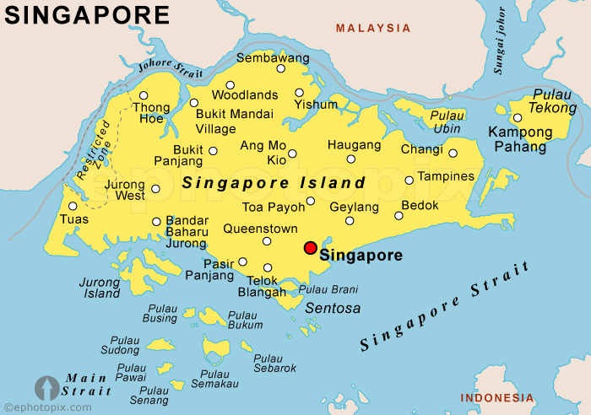

Slide 8
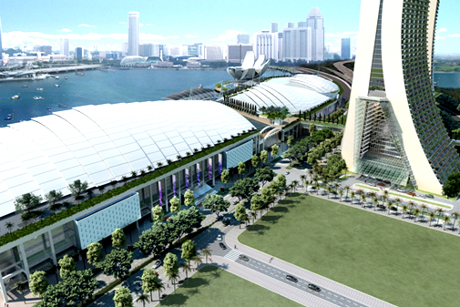
Sands Expo and Convention Center
Nothing short of spectacular…
Singapore’s newest, largest and most flexible exhibition and meeting venue proudly stands in the middle of the Central Business District, and is strategically located for success. Set to be Asia’s premiere exhibition and meeting location, Sands Expo and Convention Center offers numerous options for meetings or events of any scale, with a huge 120,000 square metres of floor space, able to host the largest conventions of up to 45,000 delegates.
The premiere venue has the largest ballroom in South East Asia, able to accommodate up to 6,600 banquet diners or 11,000 delegates, while its flexible space also enables set-up of up to 2,000 exhibition booths and 250 meeting rooms can flexibly be configured to fit your group size perfectly. Due to its central location, visitors and delegates can enjoy world-class entertainment, shopping, dining, arts and culture and accommodation options under one roof after a day of work and meetings. Singapore’s many other attractions are also all within your reach.
Be it intimate meetings or huge conventions, the Sands Expo and Convention Center caters for your every requirement, with its team of highly-experienced professionals assisting you to make your event as inspiring as it can be.

Slide 9
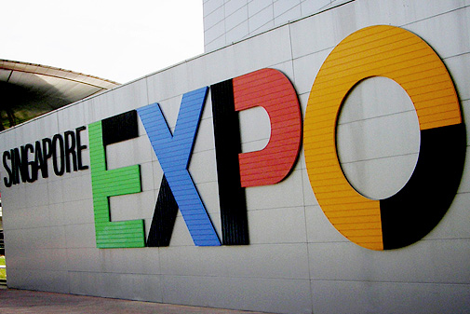
Singapore EXPO
The largest purpose-built MICE venue in Singapore…
Boasting over 100,000 square metres of indoor exhibition, 100,000 square metres of indoor convention and 10,000 square metres of outdoor activity space, the Singapore Expo is the largest purpose-built MICE venue in Singapore. It is located just five minutes drive from Changi International Airport and 15 minutes drive from the city centre.
With 10 convention and exhibition multi-purpose halls, 10 conference halls, and multiple meeting rooms, Singapore Expo can host groups of 30 to 19,000 delegates at once, with plenty of versatile spaces. Singapore Expo also offers six “V-rooms”, or mobile rooms that allow organisers and exhibitors the flexibility to decide where to hold their events.
A one-stop conventions, meetings and exhibitions venue with world-class facilities, the Singapore Expo is equipped with fibre optics backbone, wireless WIFI facilities, 3.5G mobile coverage, broadcast and satellite capabilities, broadband links, top-notch acoustics, AV sound and lighting systems, LCD panels, internet kiosks, and energy-saving building automation systems. Its other facilities include ATMs, a Business Centre, a Concierge, nursing rooms, prayer rooms, and Flavours East, Singapore Expo’s collection of fifteen F&B outlets of diverse cuisines.

Slide 10
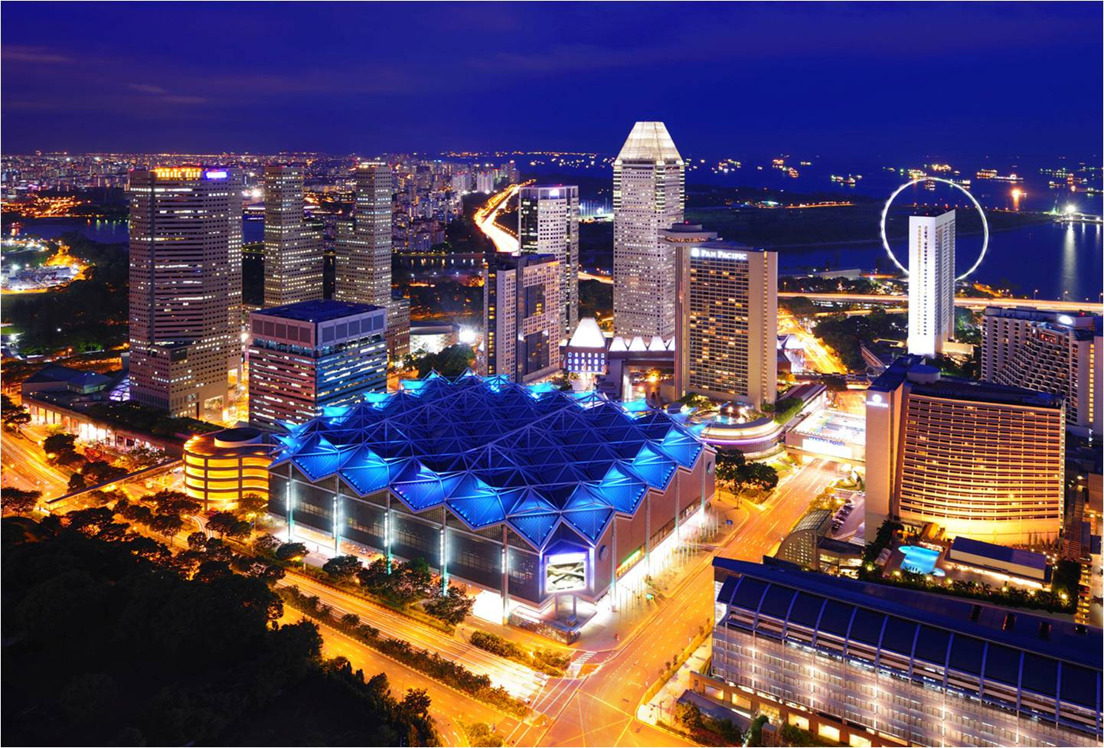
Suntec Singapore International Convention & Exhibition Centre
A fully integrated convention city…
Designed to cater to a diverse range of events, Suntec Singapore is an award-winning venue with top-notch facilities and services. It offers direct access to 5,200 hotel rooms, 1,000 retail outlets, 300 restaurants, 6 museums and a world-class performing arts centre, Esplanade – Theatres on the Bay, all within a 15-minute walk.
With 100,000 square metres of versatile floor space over six levels, Suntec Singapore is a fully integrated convention city. Some of its facilities include a column-free Convention Hall for up to 10,000 delegates theatre-style, an Exhibition Hall that can be divided into smaller areas, 31 Meeting Rooms, a 596-seat Theatre, a multi-purpose Ballroom to accommodate 1,800 people theatre-style with spacious pre-function areas, and more.
Suntec Singapore also runs the largest commercial kitchen in Singapore. Its award-winning culinary team can whip up 20,000 meals at any one time, tailored to suit various palates and dietary requirements.

Slide 11
Exhibition Facts and Figures

Slide 12
General Information
Who are typically the organizers (local? international?) Both local & International
Which services are typically handled by the organizers and which can you subcontract? Organizers will usually be responsible for temporary staff, accommodation, transport and conference registration. Stand builders, security, cleaning, freight forwarder, AV rental, rigging & way findings can be subcontracted.
Are there unions to be dealt with? If so, who and where? No
Information on Rigging? Most venues have rigging points that allow external riggers, with the exception of MBS where all contractors must engage an in-house rigger.
How are move in/move outs handled (lots of time? No time? Targeted move ins or outs? It depends on the scale of the event. Typically, move-in period is about 2-3 days and move-out usually takes less than a day.
Health and Safety standards? Some countries (like the UK) require detailed Risk Assessments and Method Statements, for example. This is not new to us as some organizers have been embarking on such practices.
Building permissions?. Yes, applicable. A Temporary Permit application has to be made

Slide 13
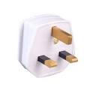
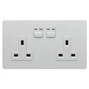
Electrics and Electricity
Typical Voltage (110/220v)? 220V
Do you need to have certified electricians? Yes, LEW is required for all electrical submissions
What are the standard plugs and sockets

Slide 14
Labour Cost Estimates
General Labourer: $120 / 8 hours (9:00 – 17:00)
Experienced Labourer $150 / 8 hours (9:00 – 17:00)
Project/Operations Executive or Manager: $250 - $300 / 8 hours (9:00 – 17:00)
Custom Stand Builders: $200 / 8 hours (9:00 – 17:00)
Rates are based on regular hours, Monday to Friday, excluding weekends, public holidays and overtime.

Slide 15
Materials Usage
Carpet - standard types, rough prices?
Needle punch – $9 per sqm
Velour – $24 per sqm
Raised flooring—standard or not standard? Heights? Materials? Costs?
100mm height – $40 per sqm
Plywood
Standard US materials available in your country? Names or equivalencies could be good (Sintra is similar to Forex in Germany, for example). Foamex in US is similar to kapaline board or compressed foam board in Singapore
In your experience, are any materials particularly cheaper or more expensive in your country as compared to the US? Generally, everything costs more in US and also additional drayage cost & labour union cost.

Slide 16
Shopping Tips
An example of a Home Improvement store where construction things can be bought (hardware, tools, paint, etc.) Home Depot or Lowes in the states
Home Fix, Horme, Buildmate and in several departmental stores island wide.
An example of an electronics store for cables, monitors, etc. Best Buy or Fry’s in the States Challenger, Harvey Norman, Best Denki, Courts, Mustafa (24 hrs)
A general sort of store where everything can be bought, a Walmart or Target type of store Giant, Mustafa (24 hrs)
Is IKEA available, if not, something similar? Ikea & Courts
16

Slide 17
EDPA International Members
Active in this country
17

Slide 18


