Slide 1
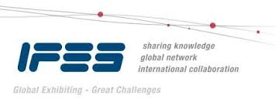

EDPA International/IFES
Country Report
A Local Knowledge Report
From Exhibit/Event Service Providers
Malaysia

Slide 2
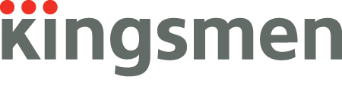
Presentation Prepared By
Kingsmen Sdn Bhd
No. 5, Jalan 6/2B
Taman Industri, Selesa Jaya
43300 Seri Kembangan,
Selangor Darul Ehsan,
Malaysia

Slide 3
MALAYSIA
A federal constitutional monarchy
Located in Southeast Asia
Consists of 13 states and 3 federal territories
Capital city: Kuala Lumpur
Putrajaya - seat of federal government
Multi-ethnic and multi-cultural

Slide 4
Government system is closely modeled after the Westminster parliamentary system
Legal system is based on common law
The Head of State known as Yang di-Pertuan Agong
The Head of Government is the Prime Minister

Slide 5
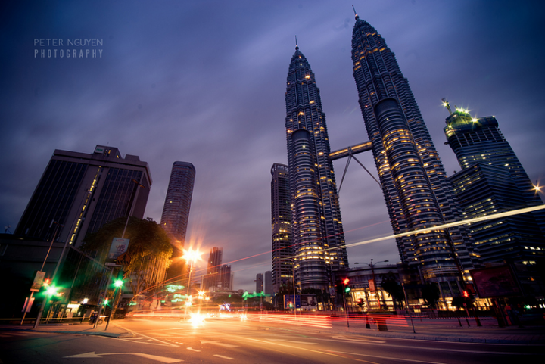
Facts & Figures
Population approx: 32,000,000 (as on August 2019)
Main language(s):
  i) Malay
  ii) English
  iii) Chinese (Mandarin, Cantonese)
  iv) Tamil
Country Size : 330,803 km²
Capital City : Kuala Lumpur, with an estimated population of 1.8 million as of 2017.
Largest City : Kuala Lumpur
Coordinates : 2°30'N 112°30'E

Slide 6
Money Issues
What is the standard currency? What is the standard conversion rate?
Malaysia Ringgit (MYR).
1USD = 4.19MYR (as on October 2019)
Are credit cards widely accepted? Should the traveller plan on dealing with lots of cash?
Major credit cards are accepted within the country. However, a traveller should plan ahead on dealing with cash.
Are credit cards required (like in the US at shows for services)?
It depends on the organisation’s terms and conditions of the services provided
Hints regarding tipping (taxis, restaurants, bars, baggage handlers, etc.) and/or haggling?
Tipping is not common practice in Malaysia and most people won't expect it. In some tourist hot spots you may notice 10% service charge added to your restaurant bill. Otherwise tipping will be discretionary.
Is there a VAT? How high is it? Who needs to pay it? Is there a way for Americans to get it refunded? Is there a useful website (in English)?
VAT in Malaysia, known as GST (Goods and Services Tax). The standard rate for VAT is 6%. http://www.gstmalaysia.org/touristrefund/

Slide 7
Size and Distance Information

Slide 8
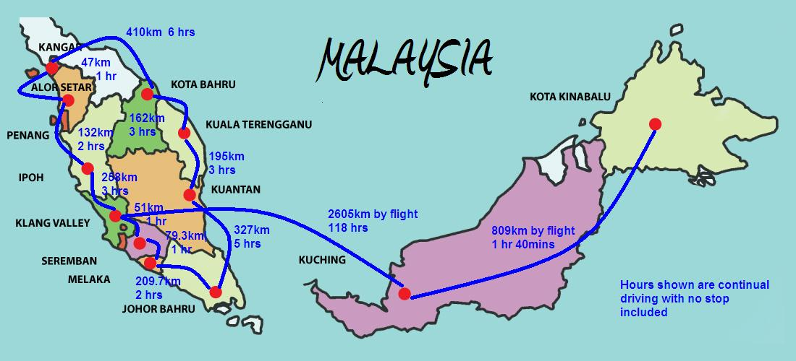

Slide 9
Location of Major Venues

Slide 10
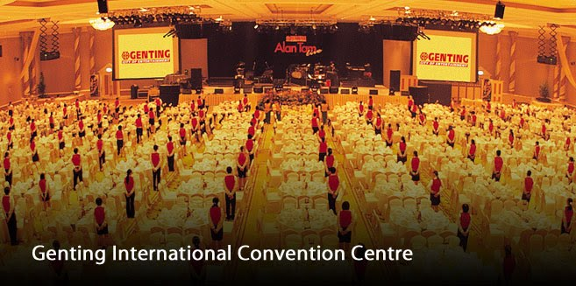
Genting International Convention Centre
(GICC)
(http://www.rwgenting.com/)
Fact 1: 9,847 sqm (106, 000 sq feet) of convention/ meeting space
Fact 2: Biggest convention/ meeting venue in Malaysia with an accompanying cluster of hotels nearby.
Location: Genting Highland, Pahang

Slide 11
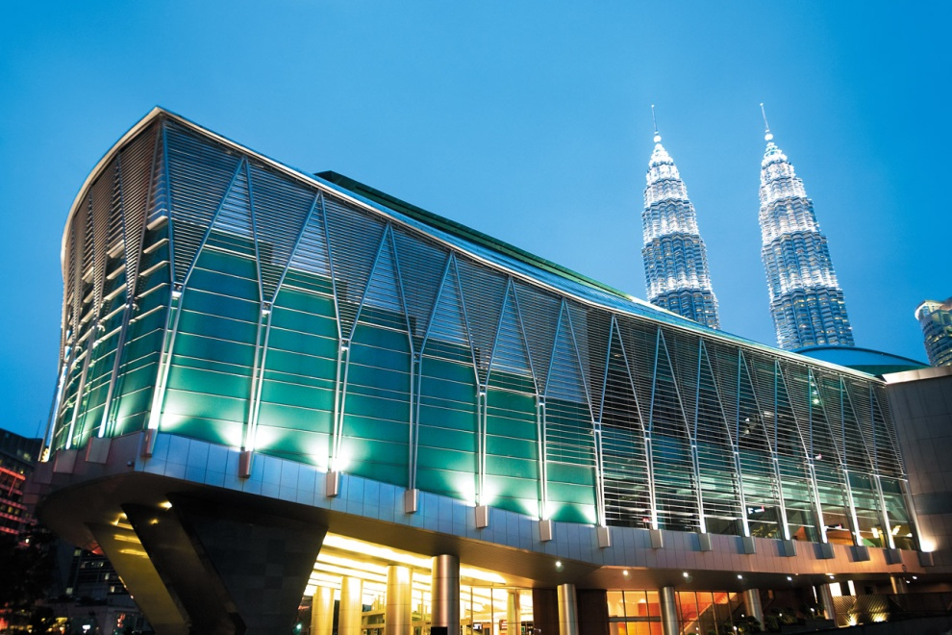
Kuala Lumpur Convention Centre
(KLCC)
(www.klccconventioncentre.com )
Fact 1: Total function space is 20,059m², inclusive of supporting areas and circulation space.
Fact 2: The facility’s gross built-up area is 120,000m² on a 7.3 acre site.
Location : Kuala Lumpur City Centre

Slide 12
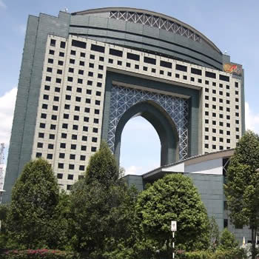
Matrade Exhibition & Convention Centre
(MECC)
(http://mecc.matrade.gov.my )
Fact 1: 24 storeys high rise building
Fact 2: 106,000 sqm of available floor space
Fact 3: One of the best places in Malaysia for Meeting, Incentives, Convention and Exhibition (MICE) with an emphasis on Trade-Centric events.
Location : Jalan Duta, Kuala Lumpur

Slide 13
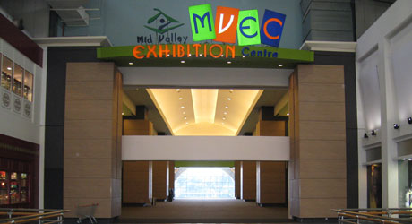
Mid Valley Exhibition Centre
(MVEC)
(http://www.mvec.com.my/)
Fact 1: 24 storeys high rise building
Fact 2: 106,000 sqm of available floor space
Fact 3: One of the best places in Malaysia for Meeting, Incentives, Convention and Exhibition (MICE) with an emphasis on Trade-Centric events.
Location : Jalan Duta, Kuala Lumpur

Slide 14
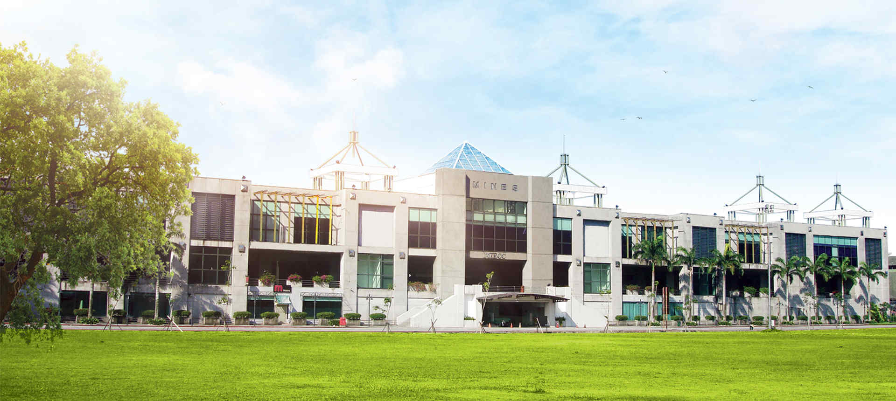
Malaysia International Exhibition and Convention Centre
(MIECC)
(http://miecc.mines.com.my/)
Fact 1: 38,000 sqm of space with a column-free area
Fact 2: 8,766 sqm of exhibition space
Location: Mines Resort City – a scenic location outside the city centre

Slide 15
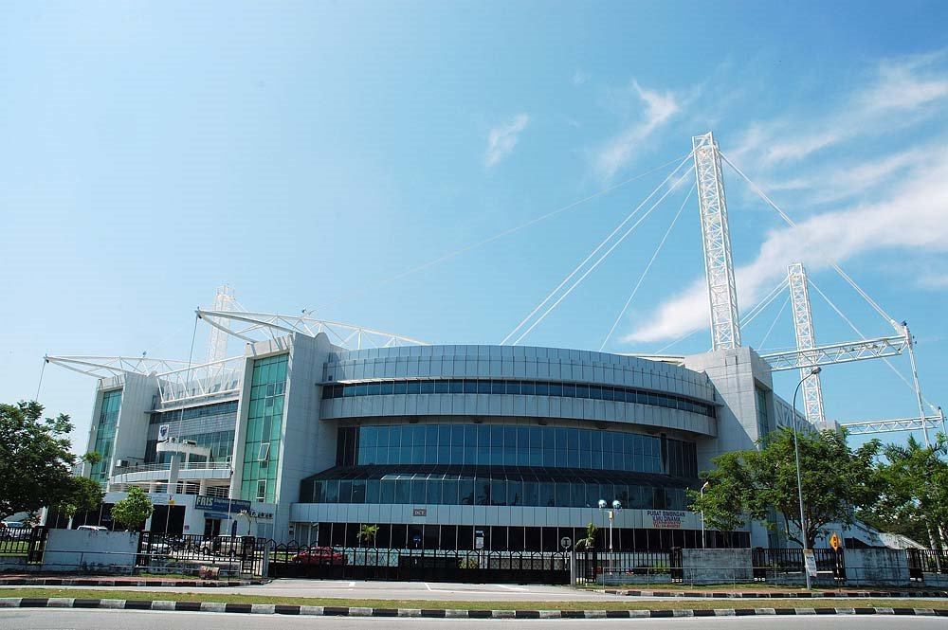
Penang International Sports Arena
(PISA)
Fact 1: Largest multi-purpose indoor venue in Northern Malaysia
Fact 2: Has the largest capacity for an indoor fully air-conditioned arena. Accomodates up to 13,000 people
Location : Strategically located in the heart of the growing township of Bayan Baru

Slide 16
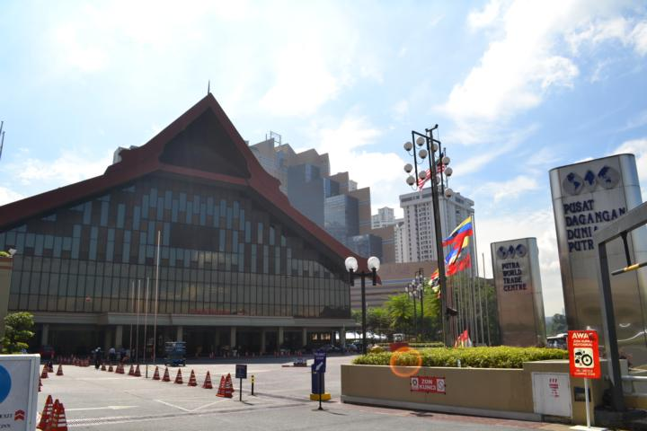
Putra World Trade Centre
(PWTC)
(http://www.pwtc.com.my/)
Fact 1: Reputed as one of the foremost exhibition venues in South-east Asia
Fact 2: Occupies an area of 253,000 sqft featuring a plenary hall, three exhibition halls, a press conference room and VIP suites
Location : Jalan Duta, Kuala Lumpur

Slide 17
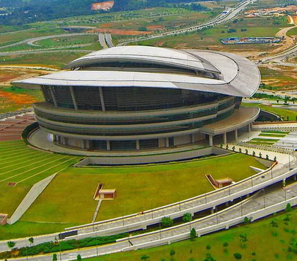
Putrajaya International Convention Centre
(PICC)
(http://www.picc.com.my/)
Fact 1: Spans over an area of 135,000 sq meters (approximately 1.3 million sq ft)
Fact 2: A focal point of Malaysia’s admin capital, it is the choice venue for national and international government functions
Location: Peak of Taman Puncak Selatan in Precinct 5

Slide 18
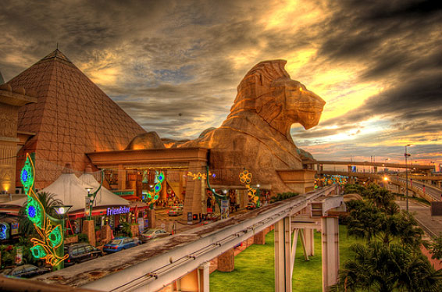
Sunway Pyramid Convention Centre
(SPCC)
(http://www.sunway.com.my/pyramid/index.asp)
Fact 1: Over 5,600sqm of unobstructed function space
Fact 2: Comprises of 8 function rooms complemented by over 50 meeting rooms in the adjacent Sunway Resort Hotel & Spa
Location: Sunway Pyramid Shopping Centre

Slide 19
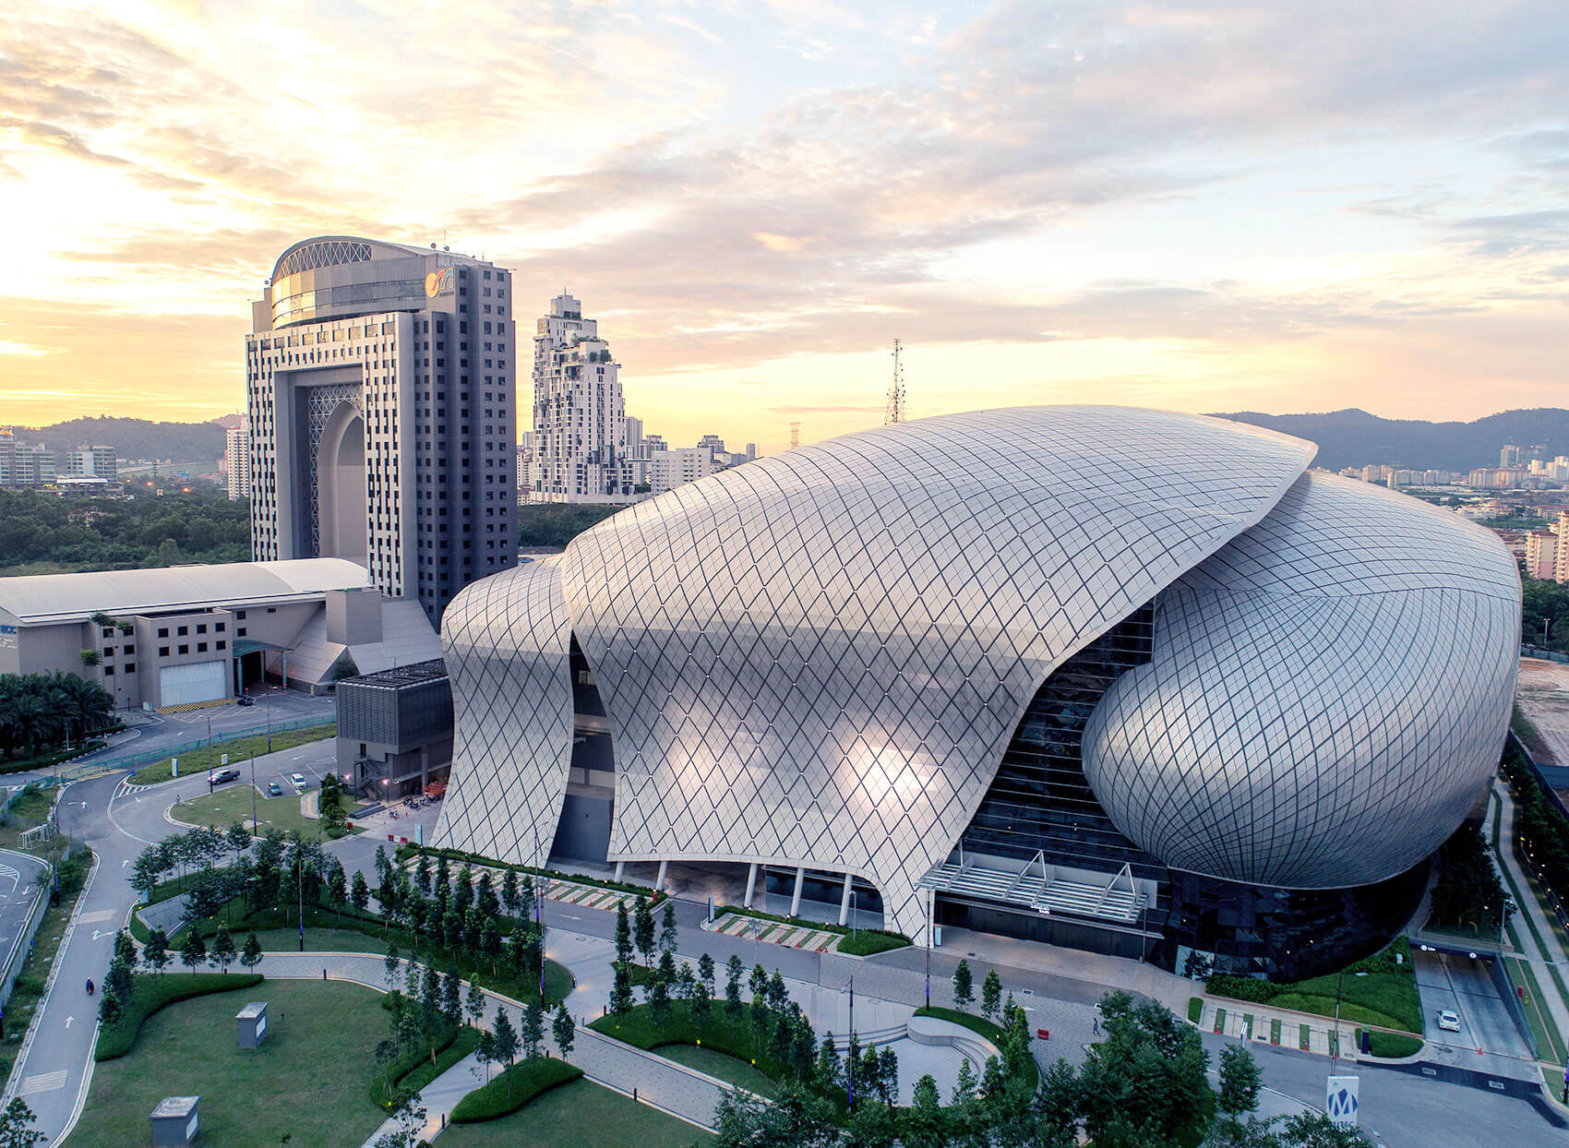
Malaysia International Trade & Exhibition Centre
(MITEC)
(https://mitec.com.my/)
Fact 1: Exhibition Space with 484,376 sq. ft. , 11 mega exhibition halls.
Fact 2: Third largest MICE (Meetings, Incentives, Conferences and Exhibitions) venue in the Southeast Asia region and the largest trade and exhibition centre in Malaysia.
Location: Jalan Dutamas 2, Kompleks Kerajaan, 50480 Kuala Lumpur

Slide 20
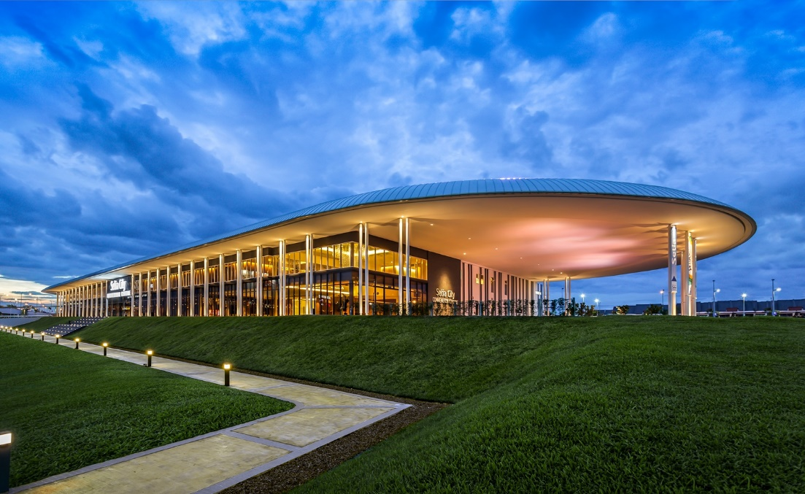
Setia City Convention Centre
(SCCC)
(http://www.setiacitycc.com/index.aspx)
Fact 1: Hall 1 & 2 with a total size of 11,800 sq m
Fact 2: The first Convention Centre in Malaysia to be certified by Green Building Index (GBI), unique building features green technologies, techniques.
Location: Setia Alam, Shah Alam, Selangor

Slide 21
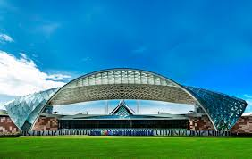
Setia SPICE Convention Centre
http://www.setiaspice.com/convention-centre.aspx
Fact 1: 1,858 sq m grand foyer
Fact 2: The first Hybrid Solar powered Convention Centre in the World
Location: Bayan Baru, Penang

Slide 22
Exhibition Facts and Figures

Slide 23
General Information
Who are typically the organizers
International and local organizers
Which services are typically handled by the organizers and which can you subcontract?
Registration services for exhibitors is handled by the organizers. We can subcontract special design booths and take in orders for furniture and electrical rental.
Are there unions to be dealt with? If so, who and where?
No unions

Slide 24
How are move in/move outs handled (lots of time? No time? Targeted move ins or outs?
Move in/move outs are in accordance with the convention centres’ rules and regulations. Targeted move in usually 2-4 days while move out usually 1-2 days.
Health and Safety standards? Some countries (like the UK) require detailed Risk Assessments and Method Statements, for example.
Such procedures are required in Malaysia. OHSAS is being practiced.
Building permissions?
Yes, we require permission for building and construction.

Slide 25
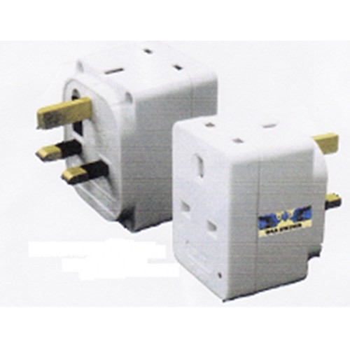
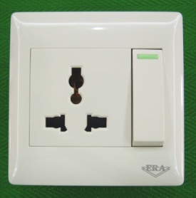
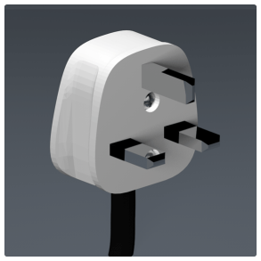
Electrics and Electricity
Typical Voltage
230V
Do you need to have certified electricians?
Yes. We need certified electricians for all electrical related matters
What are the standard plugs and sockets
13 amp plug point
http://www.st.gov.my/images/article/polisi/guidelines/guidelines%20for%20electrical%20wiring%20in%20residential%20buildings%20.pdf

Slide 26
Labour Cost Estimates
General Labourer: $50 / 8 hours(9:00-17:00)
Experienced Labourer: $50-$80 / 8 hours(9:00-17:00)
Site Supervisors: $120-$200 / 8 hours(9:00-17:00)
Custom Stand Builders: $100-$180 / 8 hours(9:00-17:00)
Rates are based on regular hours, Monday to Friday, excluding weekends, public holidays and overtime.

Slide 27
Materials Usage
Carpet - standard types, rough prices?
standard punch needle carpet start from $4/sqm.
Raised flooring—standard or not standard? Heights? Materials? Costs?
Standard, 100mm in height. Plywood platform with aluminum edge. Raw finish $40-$80/sqm (different finishing will incur different charges)
Standard US materials available in your country? Names or equivalencies could be good (Sintra is similar to Forex in Germany, for example.
Standard US materials are available in Malaysia.
Name of equivalent : Abbey Carpets
In your experience, are any materials particularly cheaper or more expensive in your country as compared to the US?
Imported materials in Malaysia are more expensive as compared to the US. Local alternative materials are available but may differ in terms of quality and colour.

Slide 28
Shopping Tips
An example of a Home Improvement store where construction things can be bought (hardware, tools, paint, etc.)
Mr.DIY https://www.facebook.com/mrdiy2u
ACE HARDWARE http://www.acehardware.com/home/index.jsp
An example of an electronics store for cables, monitors, etc.
Seng Heng http://www.senheng.com.my/updates/2012/04/senheng-grows-on-branding/
28

Slide 29
A general sort of store where everything can be bought
Giant http://www.giant.com.my/,
Tesco http://www.tesco.com.my/
Jusco http://www.aeonretail.com.my/
Econsave http://www.econsave.com.my/
Aeon Big http://www.aeonbig.com.my/
Is IKEA available, if not, something similar?
IKEA is available, located at Damansara , Cheras, Tebrau & Batu Kawan
http://www.ikea.com/my/en/store

Slide 30
EDPA International Members
Active in this country
30

Slide 31


