Slide 1
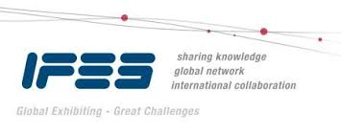

EDPA International/IFES
Country Report Template
A Local Knowledge Report
From Exhibit/Event Service Providers
South Korea

Slide 2
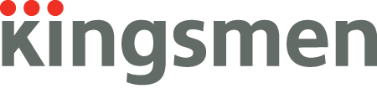
Presentation Prepared By
Kingsmen Korea Limited
Kingsmen Creative Center
Dongil-ro 350, Gwangjin-gu
Seoul, 04916, Korea

Slide 3
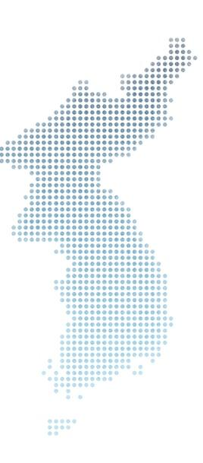
South Korea Facts and Figures

Slide 4
Facts & Figures
Population approx.: 51 million
Main Language(s) : Korean
Country Size : 99,720㎢
International Telephone Number : +82
Capital City/Population : Seoul, 10 million
- Seoul is the largest city in South Korea
Largest City/Population : Busan, 4million
- Busan is the second-largest city in South Korea

Slide 5
Money Issues
What is the standard currency? What is a standard conversion rate? Standard currency is WON. 1 USD = 1,170 won
Are credit cards widely accepted? Should the traveller plan on dealing with lots of cash?
Yes, however smaller stores or street market stalls requires payment in cash.
Are credit cards required (like in the US at shows for services)? No
Hints regarding tipping (taxis, restaurants, bars, baggage handlers, etc.) and/or haggling? Tipping is not mandatory.
Is there a VAT? How high is it? Who needs to pay it? Is there a way for Americans to get it refunded? Is there a useful website (in English)? Yes. 10% VAT. It depends on the type of project. For general construction, there’ll be 10% VAT and the Korean contractor will charge a 10% VAT to the overseas client ( included in quotation ). For design or consultancy or overall turn-key event projects, VAT may not be charged. It would be wise for clients to check with the contractor if they have projects in Korea. Americans could also hire an agency to do the refund on their behalf.

Slide 6
Size and Distance Information

Slide 7
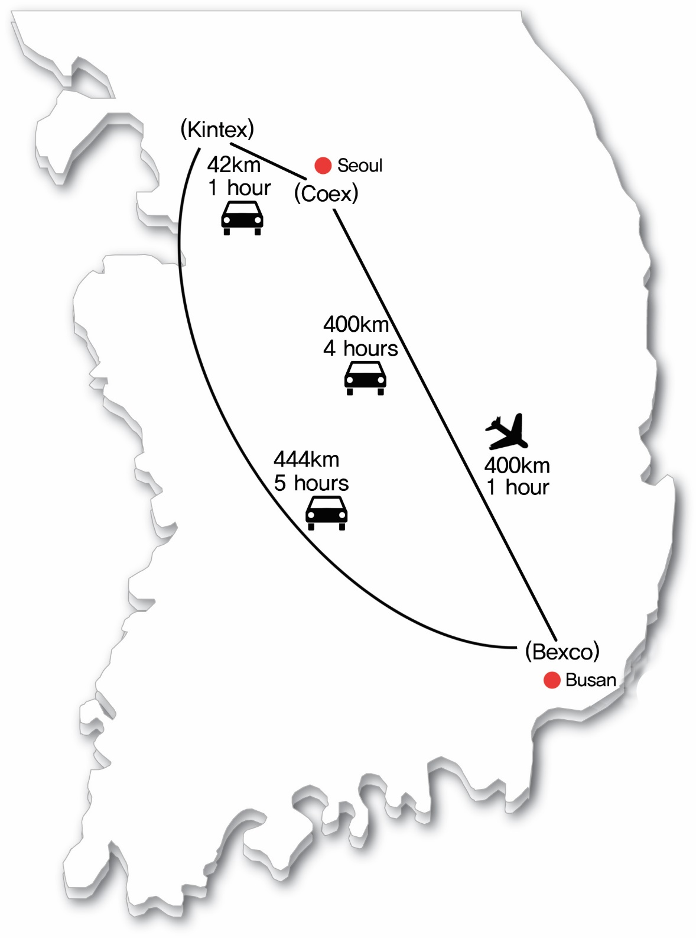
Korea
- KINTEX (Goyang)
- COEX (Seoul)
- BEXCO (Busan)

Slide 8
Location of Major Venues
- COEX
- KINTEX
- BEXCO

Slide 9
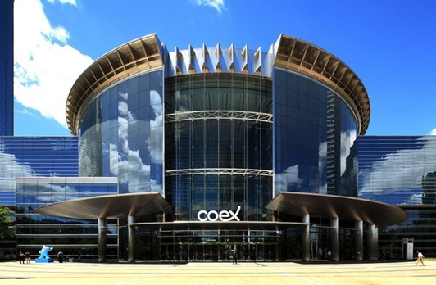
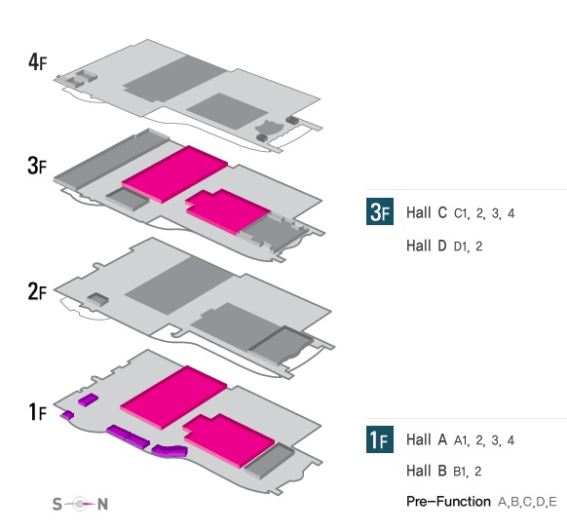
COEX(SEOUL)
http://www.coex.co.kr
Total Exhibition Area : 36,007㎡
Exhibition Hall(4 Halls)
Indoor Hall : 36,007㎡
Floor Load : 1.5ton/㎡
Ceiling Height : 8~17.5M
Divided into 2 Halls each
Exhibition Hall A : 10,368㎡
Exhibition Hall B : 8,010㎡
Exhibition Hall C : 10,348㎡
Exhibition Hall D : 7,281㎡

Slide 10
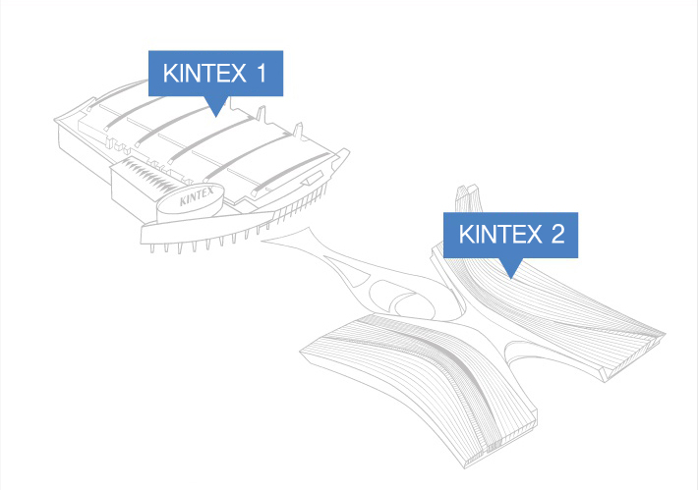
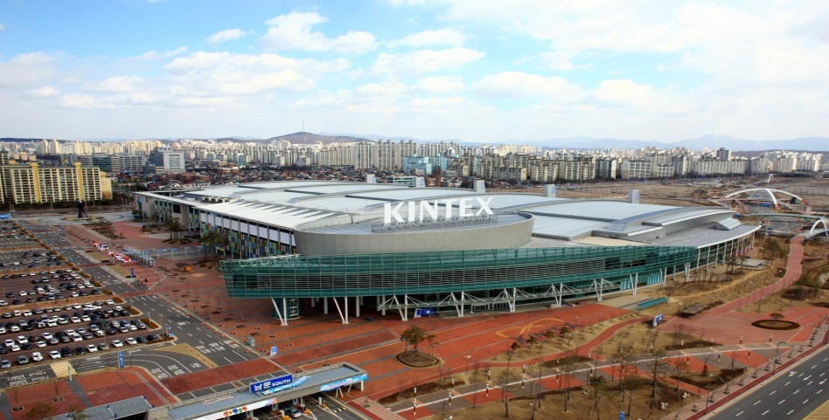
KINTEX(GOYANG)
http://www.kintex.com
Total Exhibition Area : 108,566㎡
KINTEX 1 (Hall 1 ~ Hall 5)
Indoor Hall : 53,975㎡
Outdoor Hall : 8,195㎡
Floor Load : 5ton/㎡
Ceiling Height : 15m
Divided into 2 Halls each
KINTEX 2 (Hall 6 ~ Hall 10)
Indoor Hall : 54,563㎡
Floor Load : 5ton/㎡
Ceiling Height : 10,12,15 m
Divided into 2 Halls each

Slide 11
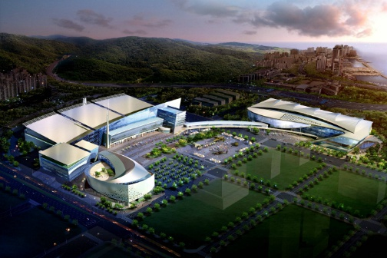
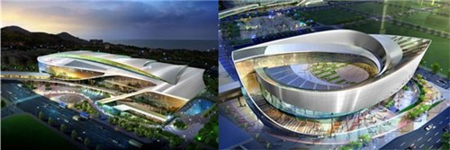
BEXCO(BUSAN)
http://www.bexco.co.kr
Total Exhibition Area : 48,509㎡
Exhibition Center 1 (Hall1 ~ Hall3)
Indoor Hall : 28,385㎡
Floor Load : 5ton/㎡
Ceiling Height : 12.5~22.5m
Lighting : Hall Lighting up to 400 lux
Exhibition Center 2 (Hall4 ~ Hall5)
Indoor Hall : 20.124㎡
Floor Load : 4.5ton/㎡
Ceiling Height : 10,12m
Lighting : Hall Lighting up to 400 lux

Slide 12
Exhibition Facts and Figures

Slide 13
General Information
Who are typically the organizers (local? international?)
Mostly local
Which services are typically handled by the organizers and which can you subcontract?
Everything can be done by Kingsmen except main electrical supply and rigging
Are there unions to be dealt with? If so, who and where?
No
Information on Rigging?
KINTEX allows. We need to submit an approval that is being issued from an assigned structural engineer.
BEXCO allows. However, it is depends on the location of the stand and weight of the
hanging structure.
COEX does not allow.

Slide 14
General Information
How are move in/move outs handled (lots of time? No time? Targeted move ins or outs?
Dependent on the exhibition. Normally, drayage fee is not charged in Korea. We can bring our own truck anytime during the move in/out periods.
Health and Safety standards? Some countries (like the UK) require detailed Risk Assessments and Method Statements, for example.
We do not have risk assessment and method statements in Korea. However, for international organisers, the submission of risk assessment and method statements may be required.
Building permissions?
Before the start of an exhibition, we will seek permission from the organiser with regards to the design and finishing materials of the detailed drawing.

Slide 15
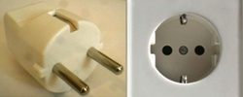
Electrics & Electricity
Typical Voltage (110/220v)
220V
Do you need to have certified electricians?
The vendors have certified electricians
What are the standard plugs and sockets?
http://en.wikipedia.org/wiki/Mains_electricity_by_country has pictures and descriptions

Slide 16
Labour Cost Estimates
General Labourer: $200/ 8 hours (9:00 – 17:00)
Experienced Labourer: $300/ 8 hours (9:00 – 17:00)
Site Supervisors: $400-$500 depending/ 8 hours (9:00 – 17:00)
Custom Stand Builders: $300/ 8 hours (9:00 – 17:00)
Rates are based on regular hours, Monday to Friday, excluding weekends, public holidays and overtime.

Slide 17
Materials Usage
Carpet - standard types, rough prices?
Needle punch ( $18 + VAT10% ) < Loop ( $30 + VAT10% ) < Velour ( $50 + VAT10% )
Price varies according to the design
Raised flooring—standard or not standard? Heights? Materials? Costs?
It depends on the design, 100mmH, Plywood, $55 + VAT10% / sqm
Standard US materials available in your country? Names or equivalencies could be good (Sintra is similar to Forex in Germany, for example.)
Mostly available in Korea
In your experience, are any materials particularly cheaper or more expensive in your country as compared to the US?
Acrylic, glass, graphic, printing, AV and lighting costs are much cheaper in Korea

Slide 18
Shopping Tips
An example of a Home Improvement store where construction things can be bought (hardware, tools, paint, etc.) Home Depot or Lowes in the states
Emart, http://emart.ssg.com/sale/main.ssg
HomePlus, http://www.homeplus.co.kr/app.exhibition.main.Main.ghs?paper_no=category
We also have a street which sells hardware, tools, paint etc..
An example of an electronics store for cables, monitors, etc. Best Buy or Fry’s in the States
HiMart, http://www.e-himart.co.kr/index.jsp?fromShop=naver_ns00
Samsung Digital Plaza, http://www.samsung.com/sec/support/digitalplaza/index_main.html
LG Best shop, http://www.lge.co.kr/lgekr/main/LgekrMainCmd.laf
Techno Mart, http://www.tm21.com/index.tm
A general sort of store where everything can be bought, a Walmart or Target type of store
Lotte Mart, http://www.lottemart.com/event/detail.do?cPage=1&categoryId=C0070605&SITELOC=CA001
Emart, http://emart.ssg.com/sale/main.ssg
18

Slide 19
Shopping Tips
Is IKEA availiable, if not, something similar?
IKEA, https://www.ikea.com/kr/ko/
LotteMart,
http://www.lottemart.com/event/detail.do?cPage=1&categoryId=C0070605&SITELOC=CA001
Emart, http://emart.ssg.com/sale/main.ssg
19

Slide 20
EDPA International Members
Active In This Country
Toin Design
20

Slide 21


