Slide 1
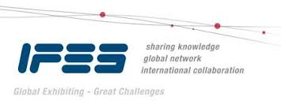

EDPA International/IFES
Country Report Template
A Local Knowledge Report
From Exhibit/Event Service Providers
Beijing

Slide 2

Presentation Prepared By
Kingsmen Beijing Co., Ltd.
306 Guo Feng Shi Dai Building, Block 7,
No. 3 Yard, Qingnian Road West,
Chaoyang District, Beijing 100123
P R China

Slide 3
Beijing Facts and Figures

Slide 4

Facts & Figures
Population approx.: 1.4 billion
Main language(s): Mandarin
Country Size: 9.6 million sqkm
Capital City: Beijing
Population: 21.7 million
Largest City: Beijing
Population : 21.7 million

Slide 5
Money Issues
What is the standard currency? RMB What is a standard conversion rate?
1 USD = RMB 7.1
Are credit cards widely accepted? Yes Should the traveller plan on dealing with lots of cash? No. E-pay is the normal way in China
Are credit cards required (like in the US at shows for services)? Yes
Hints regarding tipping (taxis, restaurants, bars, baggage handlers, etc.) and/or haggling? Tipping is not mandatory.
Is there a VAT? Yes, there is VAT. How high is it? The rate varies according to the type of products that customers purchases. For exhibition, the common rate is 6% . Who needs to pay it? Everyone who use Chinese company and pay in China. Is there a way for Americans to get it refunded? Is there a useful website (in English)? http://www.chinatax.gov.cn/eng/home.html

Slide 6
Size and Distance Information

Slide 7
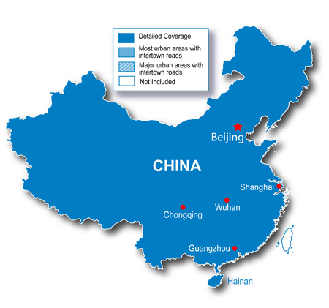
1088KM
1180km
1900km
2200km
Beijing is the Political and Culture Center of China

Slide 8
Location of Major Venues

Slide 9
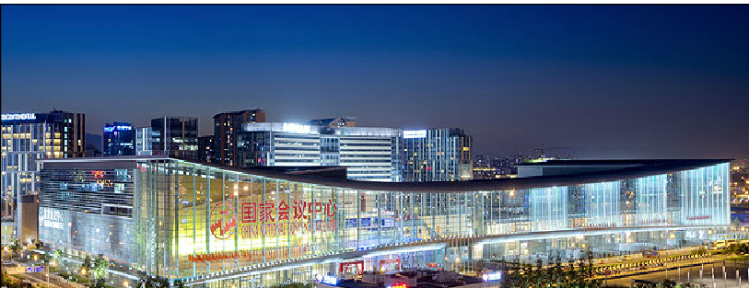
China National Convention Center
(http://www.cnccchina.com/)
China National Convention Center (CNCC) was officially launched in October 2009 to provide purpose-built convention and exhibition facilities of international standard. The Center was an important part of the 2008 Beijing Olympic Games, where it served as the main press center and international broadcasting location, as well as the venue for the fencing and pistol shooting competitions. CNCC is located in the heart of the Olympic Green adjacent to the National Stadium (Bird Nest), the National Aquatics Center (Water Cube) and the National Indoor Stadium.

Slide 10
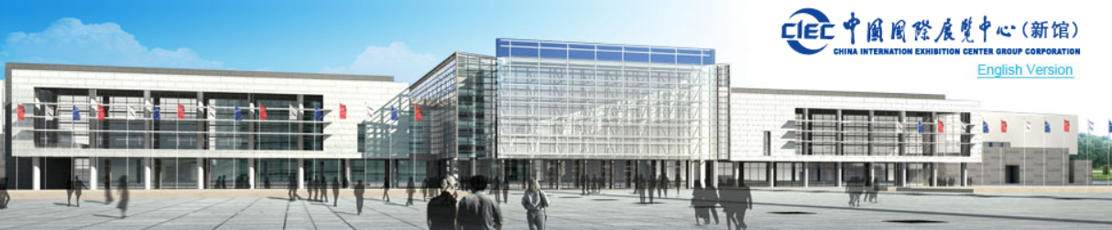
New China International Exhibition Center (http://www.nciec.com.cn/)
The upcoming New Exhibition Centre of CIEC will include buildings with a floor area of 355,000 square meters, comprising 200,000 square meters of exhibition halls and accessorial buildings, and 155,000 square meters of service buildings – such as a hotel, office and other business facilities. The total usable floor area for exhibitions will exceed 100,000 square meters.
The New Exhibition Centre of CIEC is designed to be the most advanced exhibition hall in China, using leading technology from the exhibitions industry. Each exhibition hall can be operated independently, so as to undertake small scale exhibitions. In addition, exhibition halls are also interlinked via internal corridors, so as to host large-scale trade fairs.

Slide 11
Exhibition Facts and Figures

Slide 12
General Information
Who are typically the organizers (local? international?) China industry associations are typically the organizers
Which services are typically handled by the organizers and which can you subcontract? The organizers provide visitor invitation services while booth design and construction services can be subcontracted
Are there unions to be dealt with? If so, who and where? No
Information on Rigging? Only China National Convention Center (CNCC) allows rigging but only for banners. No structure is allowed to hang from hall ceiling
How are move in/move outs handled (lots of time? No time? Targeted move ins or outs? Targeted move-ins and move-outs
Health and Safety standards? Some countries (like the UK) require detailed Risk Assessments and Method Statements, for example. No
Building permissions?. Yes, a certificate is typically issued for construction

Slide 13
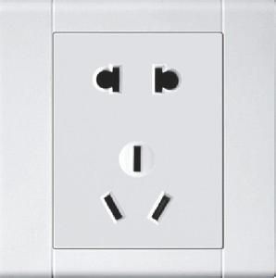
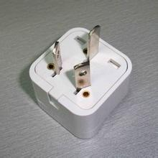
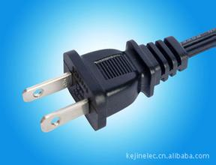
Electrics and Electricity
Typical Voltage (110/220v)?
220V
Do you need to have certified electricians?
Yes
What are the standard plugs and sockets

Slide 14
Labour Cost Estimates
General Labourer: $48 / 8 hours(9:00-17:00)
Experienced Labourer: $80 / 8 hours(9:00-17:00)
Site Supervisors: $128 / 8 hours(9:00-17:00)
Custom Stand Builders: $80 / 8 hours(9:00-17:00)
Rates are based on regular hours, Monday to Friday, excluding weekends, public holidays and overtime.

Slide 15
Materials Usage
Carpet - standard types, rough prices?
Ranges from $4.8 - $32/SQM
Needle punch, imported plush carpet with underlay
Raised flooring—standard or not standard? Heights? Materials? Costs?
Standard height – 100mm, plywood raised floor, $16/SQM for a 3-day rental
Standard US materials available in your country? Names or equivalencies could be good (Sintra is similar to Forex in Germany, for example.
In Asia, plywood is commonly used as compared to MPF.
Acrylic = Plexi glass, Forex board = Sintra
In your experience, are any materials particularly cheaper or more expensive in your country as compared to the US?
Spray painting is cheaper in China due to labour cost

Slide 16
Shopping Tips
An example of a Home Improvement store where construction things can be bought (hardware, tools, paint, etc.) Home Depot or Lowes in the states
B & Q - http://www.bnq.com.cn/
An example of an electronics store for cables, monitors, etc. Best Buy or Fry’s in the States
JU RAN - http://www.juran.com.cn/
A general sort of store where everything can be bought, a Walmart or Target type of store
Carrefour - http://www.carrefour.com.cn/
Is IKEA availiable, if not, something similar?
Ikea is available
16

Slide 17
EDPA International Members
Active in this country
17

Slide 18


