Slide 1

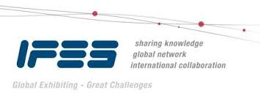
EDPA International/IFES
Country Report Template
A Local Knowledge Report
From Exhibit/Event Service Providers
Japan

Slide 2
Japan Facts & Figures

Slide 3
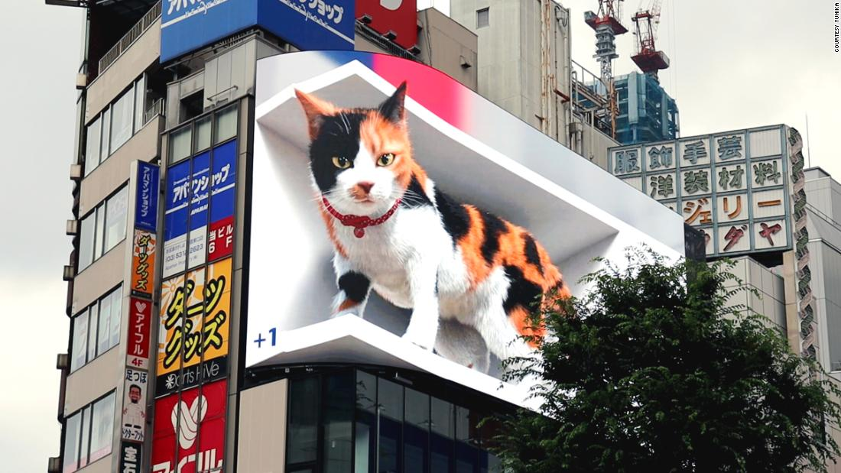
Facts & Figures
Population approx: 126 million
Main language: Japanese
Country Size: 380,000 sq.km
Ethnic Diversity: 98.5% Japanese
Capital City, population: Tokyo, 14 million
Largest City, population: Tokyo, 14 million
Other (GDP): approx. $5 trillion USD
Where else but Japan? A digital cat billboard in Shinjuku

Slide 4
Money Issues
What is the standard currency? What is a standard conversion rate?
Japanese Yen (JPY). 1 USD = 115.449 JPY as of January 28 2022 (https://www.xe.com/currencyconverter/)
Are credit cards widely accepted? Should the traveler plan on dealing with lots of cash?
While department stores, hotels. and some restaurants accept credit cards, many smaller businesses in Japan do not. This has started to change with the use of ApplePay and other Apps like PayPay. Be sure to have cash. Many show organizers and official suppliers do not accept credit cards for payment. (Wire transfer only.)
Are credit cards required (like at shows in the US for services)?
No, but they are becoming more accepted as a form of payment for show services.
What about tipping (taxis, restaurants, bars, baggage handlers, etc.)?
There is no custom of tipping in Japan. It is considered an insult to offer a tip

Slide 5
Money Issues
Is there a VAT?
There is no VAT in Japan. Only a general sales tax on all goods and services.
How high is it?
The tax rate is 10%.
Who needs to pay it?
All companies need to pay this tax. This amount can be refunded only in very special circumstances and is often only given between countries and their government agencies. (For example, NPOs or NGOs can be refunded.)
Is there a way for get it refunded?
Foreigners traveling in Japan can visit tax free related shops. The tax will be waived if you show your passport with the travel visa stamp. Japanese Nationals, permanent residents, or those who reside in Japan are not eligible.
Is there a useful website in English?
https://tax-freeshop.jnto.go.jp/eng/shopping-guide.php

Slide 6
Size and Distance Information

Slide 7
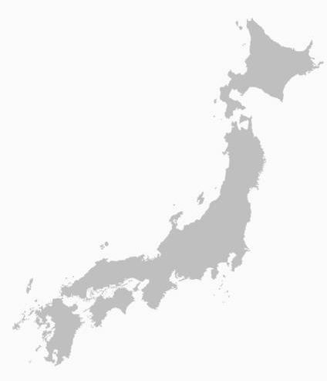
Japan
Driving Distances
Sapporo
Semi trailer rates per truck (from 4T) from TYO – OSA are approx. $1400-2000USD each way.
Aomori
Hours shown are continual driving times with no stops included.
740km
8hours
Nagoya
Tokyo
Kyoto
Hiroshima
Osaka
315km
3.5hours
Fukuoka
330km
4hours
180km
2.5hours
Nagasaki
280km
3.5hours
150km
1.5hours

Slide 8
Location of Major Venues

Slide 9
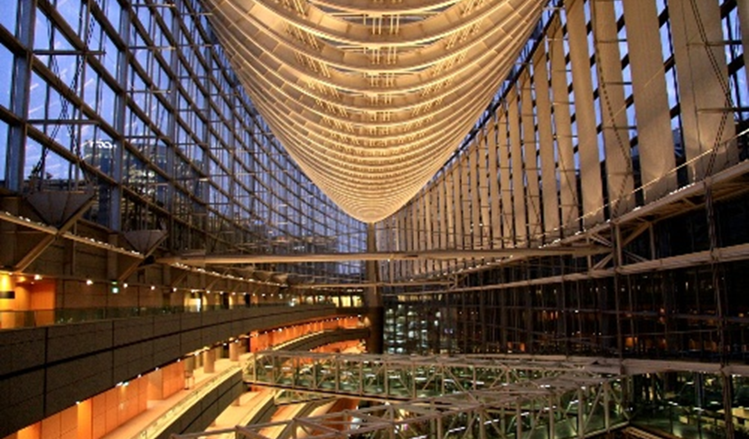
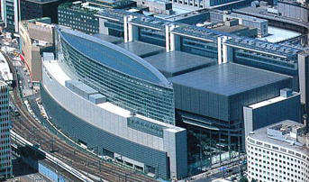
Tokyo International Forum
http://www.t-i-forum.co.jp/en/
Tokyo International Forum is located in central Tokyo, Japan. It is a multi-purpose center which hosts renowned international events linked to a variety of industries, national and international exhibitions, and trade shows.
The forum boasts multifunctional and flexible areas and is capable of hosting different kinds of events. The Forum houses 8 equipped halls ranging from multi-level theaters to flat open event spaces, 2 theaters, 34 multi-purpose conference rooms, a lobby gallery, a lounge, and a business center.
There are many environmental initiatives incorporated into the building, such as solar panels, greenery on the roofs, and a waste water recycling system.

Slide 10
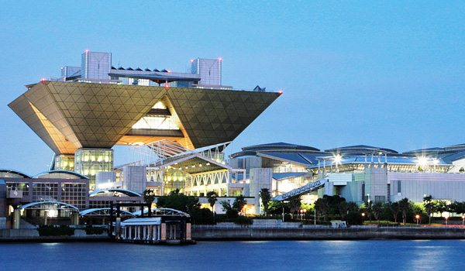
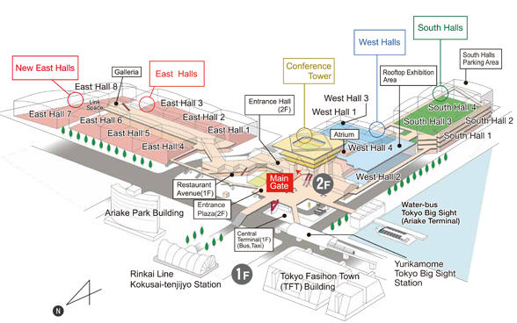
Tokyo International Exhibition Center
http://www.bigsight.jp/english/
Popularly known as Tokyo Big Sight, the Tokyo International Exhibition Center is the largest and one of the most prominent convention venues in Japan.
Established in 1996, the exhibition center is a multi-functional venue with distinct architecture and design. It offers 230,873.07 sqm of total floor area and an exhibition area of 102,887 sqm (1,107,470 sq ft).
The center is divided into three major areas: the East Exhibition Hall, the Conference Tower and the West Exhibition Hall, and is well furnished with high-tech features and amenities.
With 12 major halls, conference rooms, excellent value-added service. and outstanding facilities, Tokyo Big Sight is Tokyo’s primary platform for both trade and consumer activities.

Slide 11
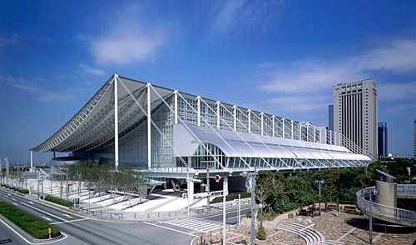
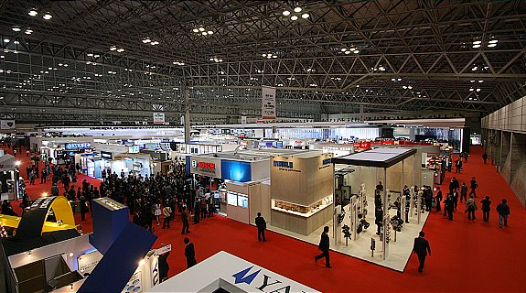
Makuhari Messe
http://www.m-messe.co.jp/en/index.html
Makuhari is a commercial district outside central Tokyo, along the shores of Tokyo Bay in Chiba Prefecture. In the late 1980s, the district was built on reclaimed land in a modern style of architecture and with noticeably organized city planning that includes elevated promenades and walkways as well as wide, well designed streets.
The district's attractions include a convention center, baseball stadium, shopping, dining, and an expansive seaside park.
Makuhari's main attraction is the Makuhari Messe International Convention Complex, which is the second largest convention center in Japan. The center's 11 exhibition halls, conference hall, and 9,000 seat event hall has hosted major trade shows and technology exhibitions such as the annual Tokyo Game Show, Tokyo Auto Salon and Jump Festa.

Slide 12
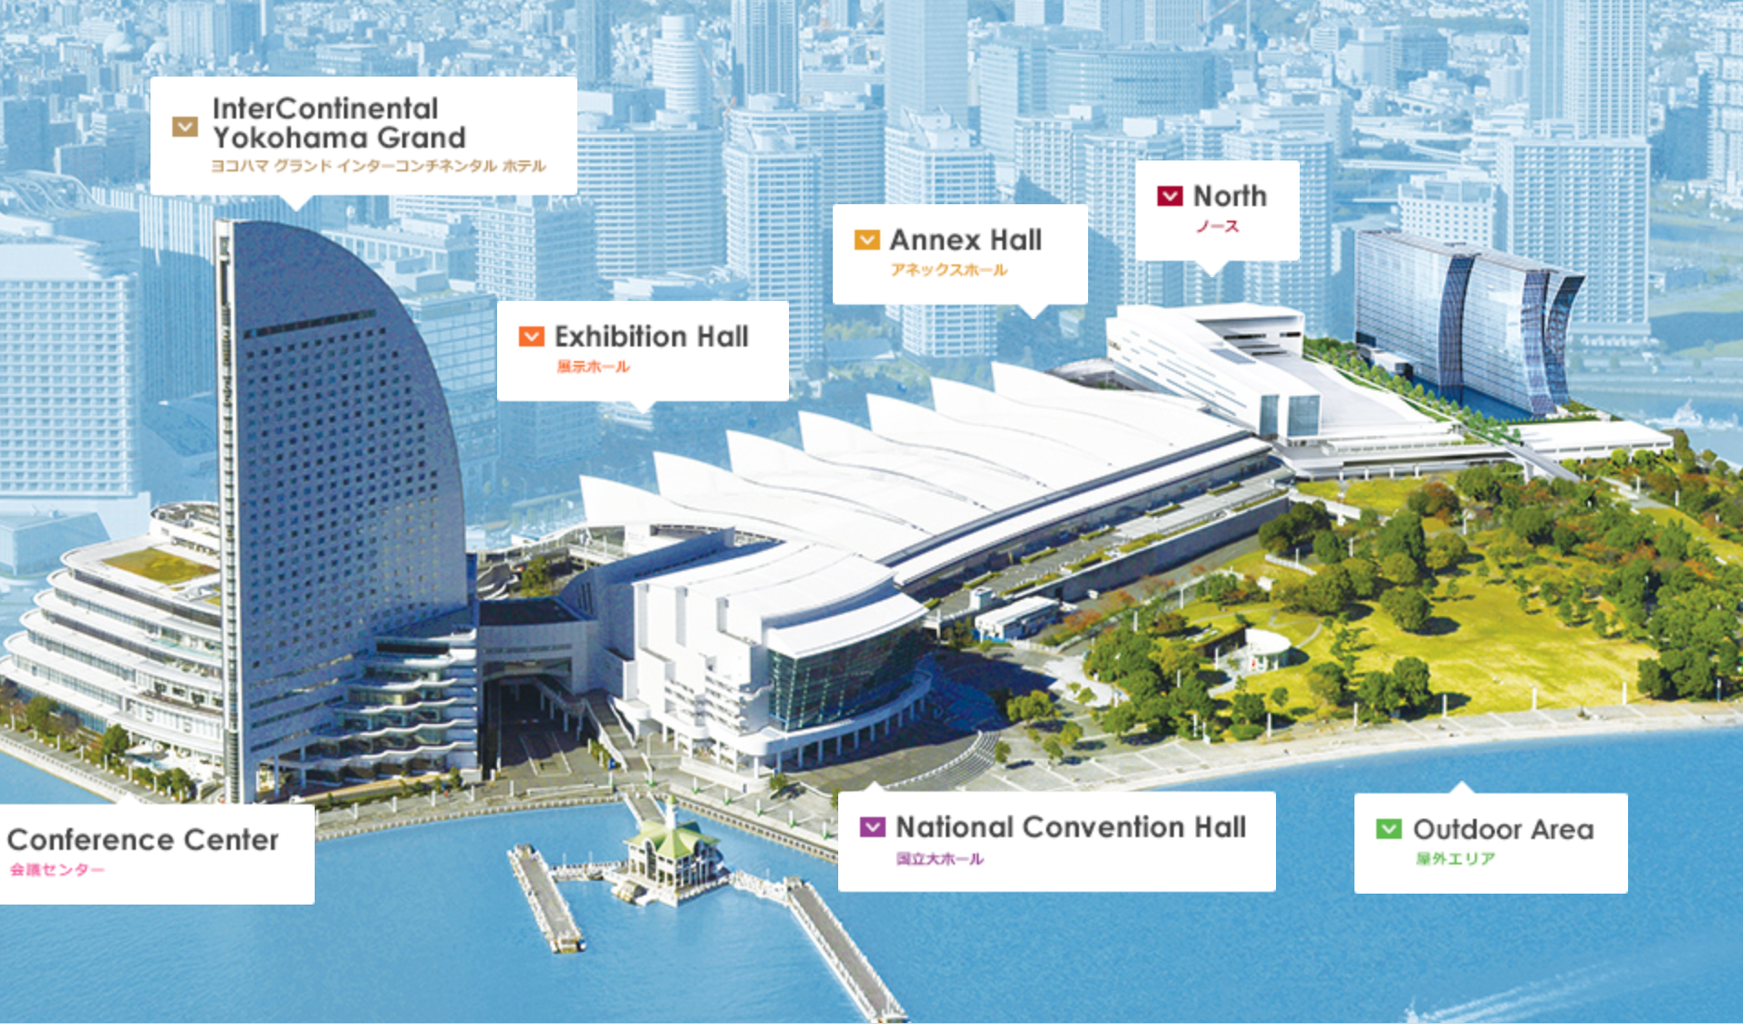
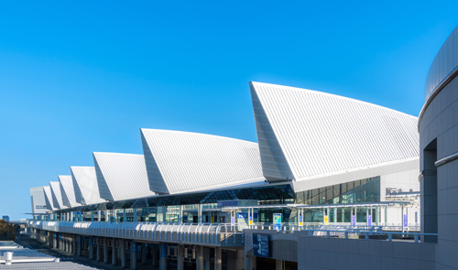
Pacifico Yokohama
http://www.pacifico.co.jp/english/index.html
PACIFICO Yokohama, a world-class convention complex, is located on the waterfront of "Minato Mirai 21," a futuristic town in Yokohama.
Yokohama has been a window to the world since the port opened to trade in 1859. Capitalizing on Yokohama's history and internationality, PACIFICO Yokohama has hosted many conferences.
PACIFICO Yokohama provides optimum venues and services including accessibility, comfortable, ambient surroundings, up-to-date facilities, and excellent support systems provided by experienced staff.

Slide 13
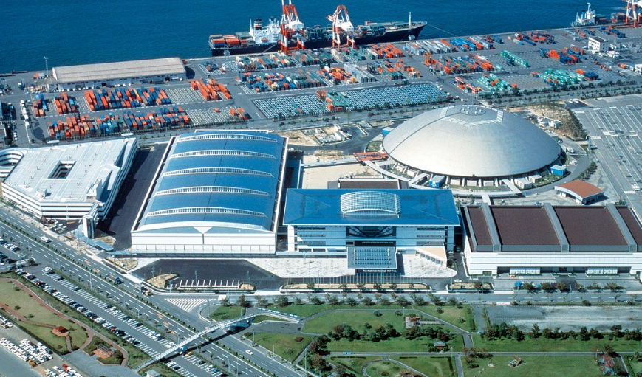
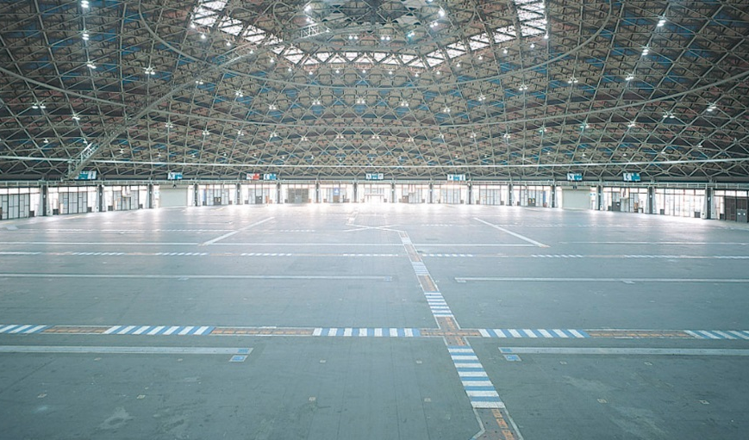
Nagoya International Exhibition Hall
http://portmesse.com/en/outline
Also known as Portmesse Nagoya, Nagoya International Exhibition Hall is nestled in Nagoya, which is less than two hours by bullet train from Tokyo.
Nagoya Port Messe has hosted various international events for a variety of industries.
The exhibition center boasts multifunctional and flexible areas and a capability to host all kinds of events. Thousands of visitors, organizers, and exhibitors gather at the exhibition halls to take advantage of functional and flexible spaces.

Slide 14
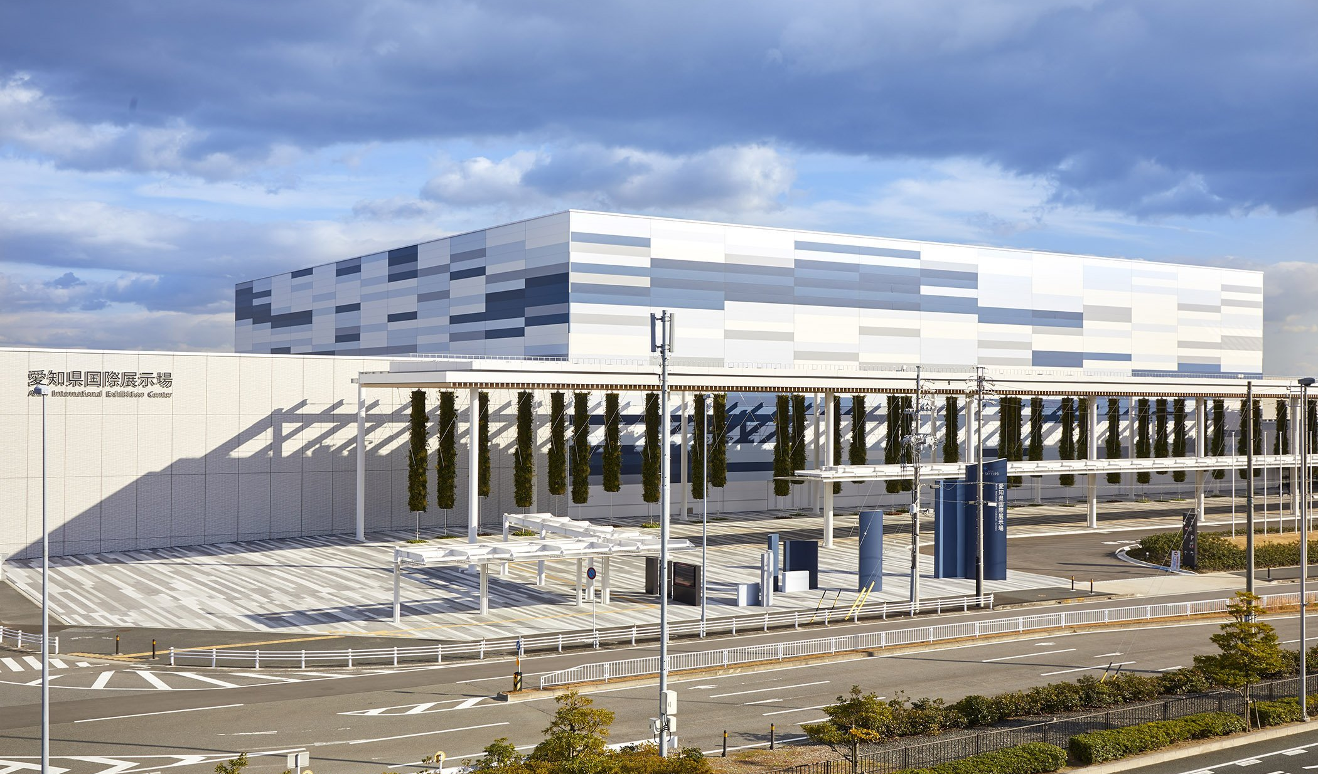
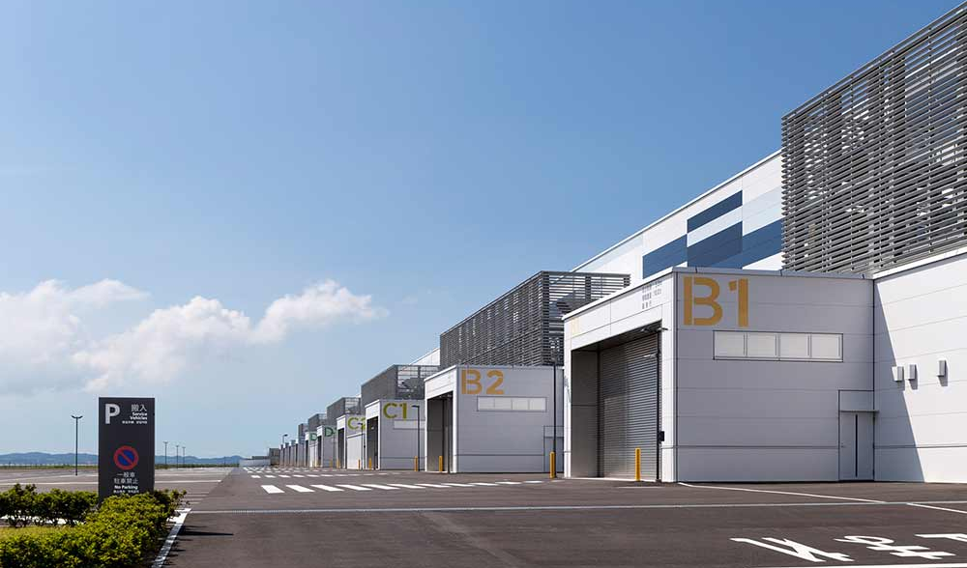
Aichi International Exhibition Center
https://www.aichiskyexpo.com/?lang=en
The Aichi Sky Expo is the first exhibition center in Japan directly connected to an international airport (Chubu Centrair International Airport), making it easily accessible for global visitors.
This facility is equipped with 6 exhibition halls, 18 conference rooms, an outdoor general-purpose site of about 33,000 square meters, and a parking lot with 3,447 parking spaces. At 60,000 square meters, Aichi Sky Expo is the fourth largest exhibition center in Japan.
Aichi Sky Expo is a permanent bonded exhibition center where exhibits arriving from overseas are not subject to import duties. Instead there is a simple process to enter the facility. This allows participating companies to make full use of their exhibition time.

Slide 15
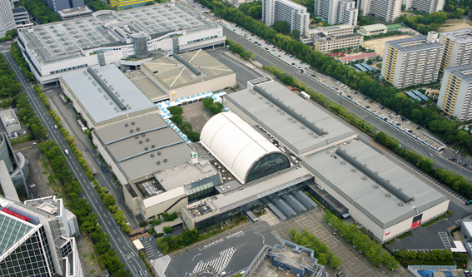
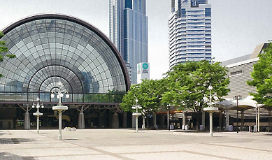
Intex Osaka
http://www.intex-osaka.com/en/
For more than 24 years, the Intex Osaka has hosted more than 2,250 trade shows, events, and exhibitions in the Cosmosquare district of Osaka. Operated by the Osaka International Business Promotion Center (IBPC), the venue boasts six exhibition halls of various sizes, and is the largest exhibition venue in western Japan.
Intex Osaka has hosted many large-scale events, such as the international conference Saibos 2012 Osaka, and the International Food Expo UTAGE 2017.
This pioneering venue has drawn more than 88 million trade visitors from Japan and abroad. It plays a pivotal role in energizing the country's economy, tapping on new trends and technologies and being a medium of international exchange within the spheres of economy and culture.

Slide 16
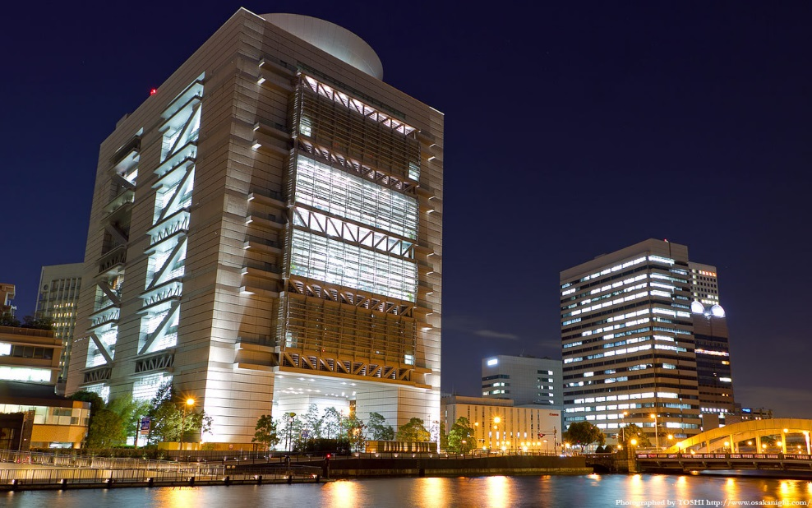
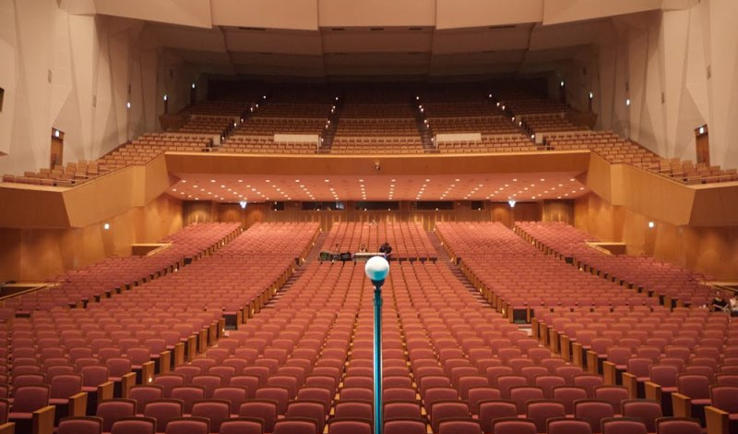
Osaka International Convention Center
http://www.gco.co.jp/en/
The Osaka International Convention Center, also known as “Grand Cube Osaka”, is located in Nakanoshima, the center of Osaka.
This facility, used for various conferences, concerts and exhibitions, provides high-quality service with the emphasis of bringing people together through various exchanges.
The Osaka International Convention Center Corporation was founded as a joint venture between Osaka Prefecture and the Osaka business community. Inheriting the foundation from the time of the former Osaka International Trade Center, the company was entrusted by Osaka Prefecture with the management of the Osaka International Convention Center.

Slide 17
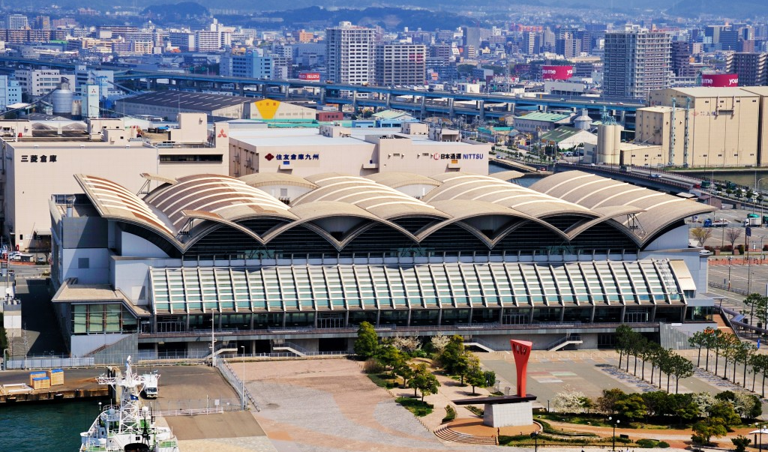
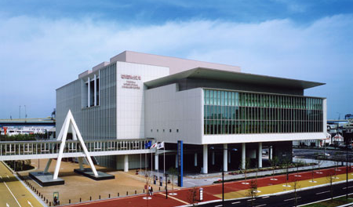
Fukuoka Convention Center
http://www.marinemesse.or.jp/eng/
The versatile Fukuoka Convention Center is able to host any event, from large-scale exhibitions, conventions, and assemblies to sporting events, concerts, and other types of entertainment. The “Ozumo Kyushu Basho (Fall Sumo Tournament)” is held here every November and is a tradition that Fukuokans have come to know and love.
One of the main buildings, the Marine Messe, is a spacious venue that provides the optimal environment for large-scale exhibits--from yachts and cruisers to automobiles. Promenades boasting views of Hakata Bay and Seaside Mall can also be used for exhibitions.
Accessibility features include priority parking for persons with disabilities; wheelchair-accessible bathrooms; wheelchair rental; and elevators.

Slide 18
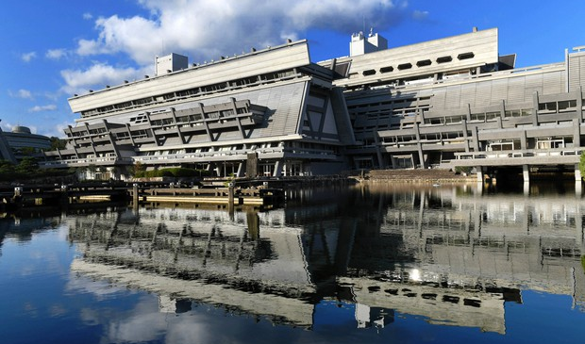
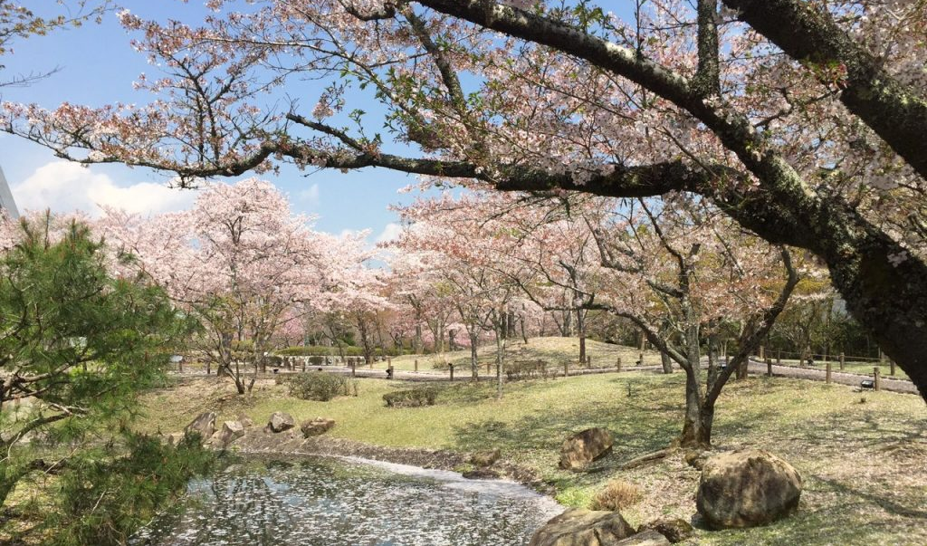
Kyoto International Convention Center
https://www.icckyoto.or.jp/en/
ICC Kyoto is located in Kyoto, the cultural center of Japan, about 15 minutes from the city center.
Since its opening in 1966, it has formed a dedicated conference complex area with its expansive grounds of 156,000 sqm, containing the Main Hall, Event Hall, New Hall, Annex Hall, and Japanese garden, as well as adjacent hotels.
ICC Kyoto was designed for “humans gathering and conversing within nature,” and it has a Japanese garden that borrows the scenery of the picturesque Lake Takaragaike.
ICC Kyoto has welcomed 12,000,000 guests since it’s opening, and recently opened a multi-purpose New Hall in 2018.

Slide 19
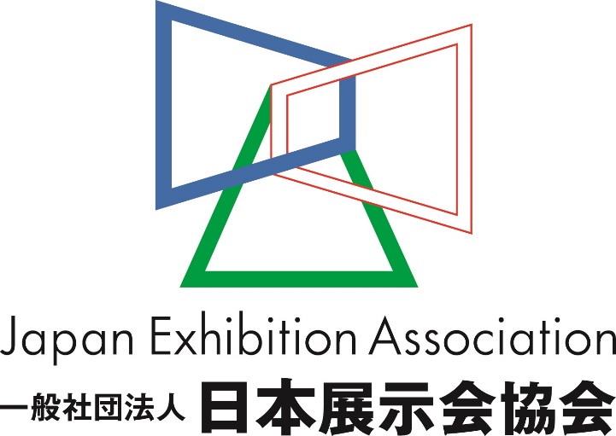
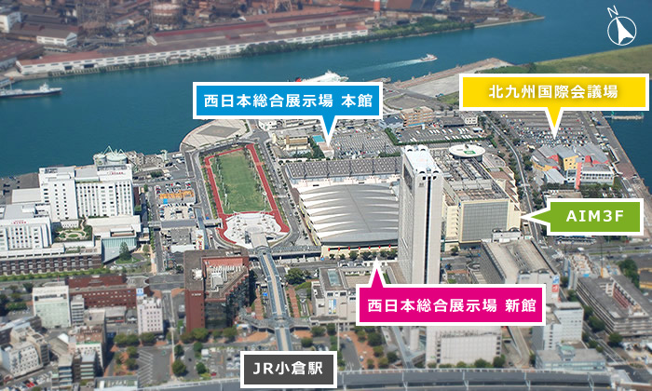
Exhibition Associations in Japan
The Japan Exhibition Association (JEXA) was founded in 1967 as the "Harumi Council," by a group of exhibition organizers. The council gained general corporate judicial personality in 2013, and currently has over 300 members consisting of organizers, show venue management and service companies, and supporting enterprises. (https://www.nittenkyo.ne.jp/en)
The Kitakyushu Convention and Visitors Association is dedicated to fostering industrial developments and promoting trade in Western Japan by presenting industrial products. The association aims at invigorating the region’s economy and promoting its culture by inviting and supporting conventions in Kitakyushu City. (https://hello-kitakyushu.or.jp/en/)

Slide 20
Exhibition Facts and Figures

Slide 21
General Information
Who are the typical organizers?
The local industrial associations are usually the organizers.
Which services are typically handled by the organizers and which can you subcontract?
Most services are handled by the show organizers. Only areas which require construction are handled by the contractors.
Are there unions to be dealt with? If so, who and where?
There are no unions, however there are worker`s organizations which dictate working hours and breaks as based upon national labor laws.
What about rigging?
Rigging is very rarely permitted. Check the exhibitor manual to see if it’s allowed. These three shows allow rigging in certain instances (if your booth is at least a certain size, for example): CEATEC Japan, The Tokyo Game Show. and the Tokyo Motor Show.
How are move in/move outs handled?
Most shows allow 2-3 days for set up. Dismantle times can range from a few hours to a few days.
Are there health and safety standards
Your booth must comply with the Building Standards Act and Construction Contractors Law.
Do exhibitors need building permissions?
There are two kinds of construction contractor licenses.
Notes:
Last question?

Slide 22
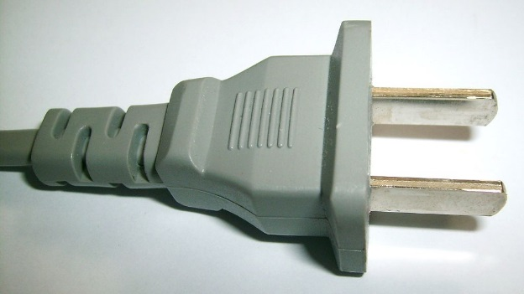
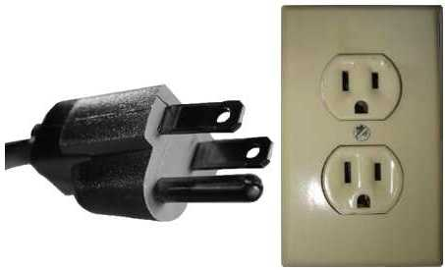
Electrics and Electricity
What is the typical voltage (110/220v)?
100V(S), 200V(S single phase), and 200V (3 phase). Please note Eastern Japan is 50hz and Western Japan is 60hz.
Do you need to have certified electricians?
Yes. Main power drops from the hall are performed by the official electrical contractor for the show. Certified electricians are required for the secondary booth wiring.
What are the standard plugs and sockets
A two-blade plug is typical. You will need to inform your supplier if you need a third pin ground. Please arrange in advance if you need a transformer or other plug types (European, UK, etc.)

Slide 23
Materials Usage
What type of carpet should exhibitors expect?
Needle Punch Carpet (exhibition standard), US$18-24/sqm including installation
Are raised floors typical?
They are not typical. If used, the standard height of rental raised flooring is 100mm. The cost varies, but is typically US$100/sqm. Check show regulations to see if disability access ramps are required.
What standard US materials are available in Japan?
The materials available in Japan are similar to the ones found in the US.
In your experience, are any materials particularly cheaper or more expensive in your country as compared to the US?
Wall paper finishing for wooden made structures is less expensive in Japan compared to painting and laminating.

Slide 24
Shopping Tips
An example of a Home Improvement store where construction things can be bought (hardware, tools, paint, etc.) Home Depot or Lowes in the states:
    Kohnan https://www.hc-kohnan.com/hc/eng003_kaisya/
    Viva-Home https://www.vivahome.co.jp/english/
An example of an electronics store for cables, monitors, etc. Best Buy or Fry’s in the States:
Yodobashi Camera http://www.yodobashi.com/
Bic Camera http://www.biccamera.com/
A general sort of store where everything can be bought, a Walmart or Target type of store:
Ito-Yokado http://www.7andi.com/en/company/index.html
  Aeon https://www.aeon.info/en/
Don Quijote http://www.donki.com/index_en.php
Is IKEA available, if not, something similar?
Yes. Also, in Japan, Nitori is known for being a low-priced furniture and home goods store
Nitori http://www.nitori.co.jp/en/

Slide 25
EDPA International Members
Active in this country
Id
25

Slide 26


